Slide 1
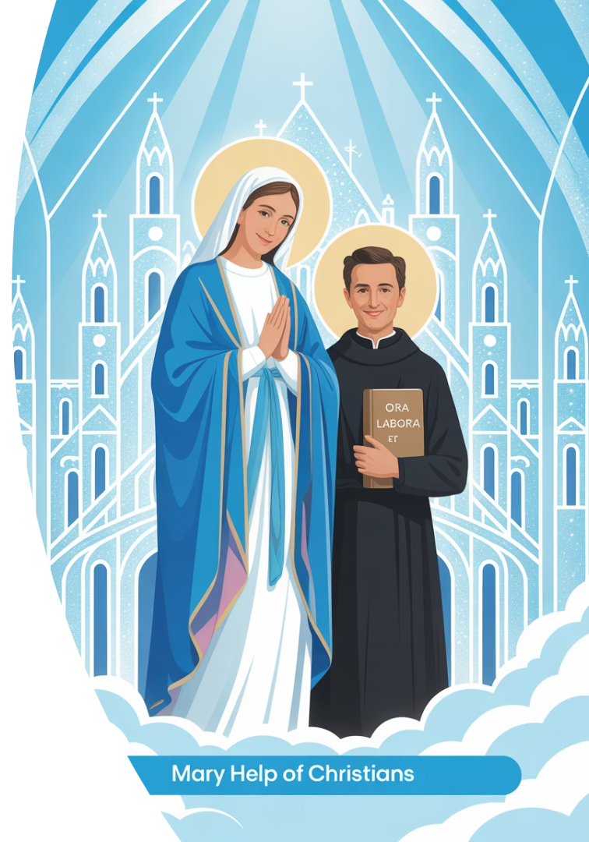
Novena to Mary Help of Christians
In the Spirit of St. John Bosco
"Have faith in Mary, and you will see what miracles are." St. John Bosco
by Abba Halibo

Slide 2
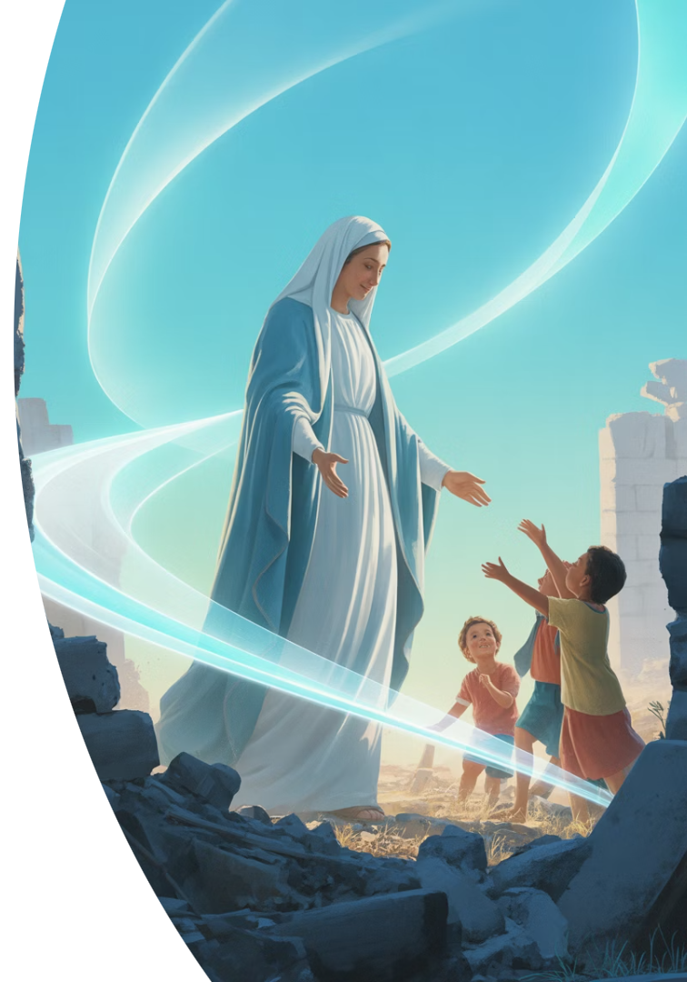



A Mother in the Ruins
Walking Among Us
Singing Hope
Mary walks where bombs have fallen. Where children cry in silence.
In the dust, she still sings hope. She is Help. She is Light.
Reaching Into Need
She is Heaven's hand reaching into our need.

Slide 3
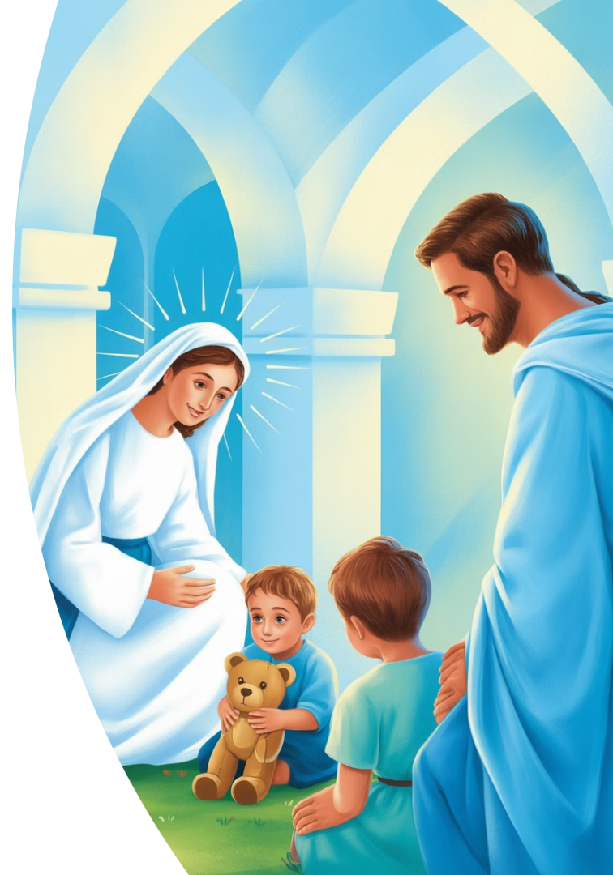
Mary, Help of the Wounded
Land of Trauma
Don Bosco's Wisdom
The land here is marked by trauma. War has scarred the youth.
"Never let a child feel they are alone."
Our Prayer
"Mother, hold those who carry invisible wounds. Teach us how to stay close."

Slide 4
Mary, Music in the Silence
The Yearning
Don Bosco's Way
Our Prayer
There is a silence in the hearts of the young. A deep yearning that needs expression.
Don Bosco brought joy through music, games, and prayer to fill this silence.
"Mary, awaken music in our souls. Let it be praise, not escape."

Slide 5





Mary, Companion of the Dreamers
Don Bosco's Dreams
Dreams that became homes for the poor.
Our Dreams Today
A parish alive with love, laughter, and learning.
Mary's Example
You know what it's like to believe in the dark.
Our Prayer
"Mother, breathe courage into our dreams."

Slide 6
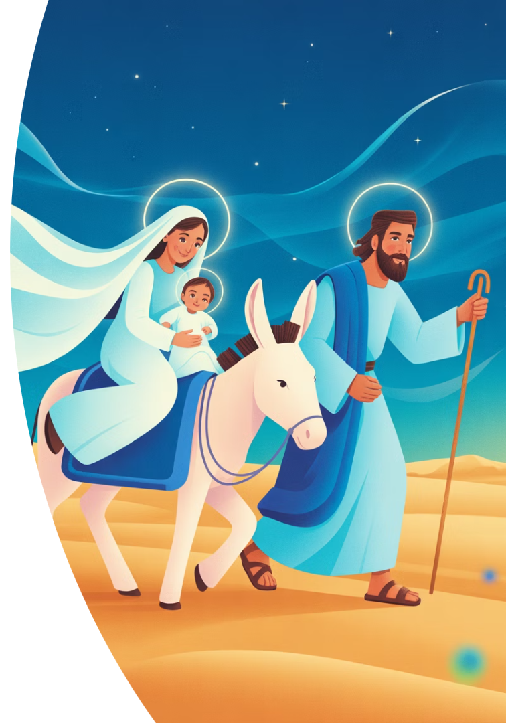



Mary, Mother of Immigrants
The Flight
You fled to Egypt with Joseph and Jesus.
Our Reality
Our young people are leaving. Desperate. Disillusioned.
Our Prayer
"Mary, plant hope in this land. Teach us to be home."

Slide 7








Mary, Queen of the Oratory
Love
Song
Don Bosco's Oratory was built with love.
Music filled the halls and hearts.
Community
Trust
A place where no one is forgotten.
Faith in God's providence guided all.

Slide 8






Mary, Teacher of Joy
True Joy
Joy that comes from trust, not circumstances.
Necessary, Not Luxury
Don Bosco believed holiness and joy walk together.
Expressions of Joy
In music, friendships, Mass, and youth gatherings.

Slide 9



Mary, Intercessor in Battle
Our Refuge
In times of plague and war, your name was our refuge.
Don Bosco's Trust
He entrusted his mission to your protection.
Our Entrusting
We entrust the trauma of war and our fears to you.

Slide 10
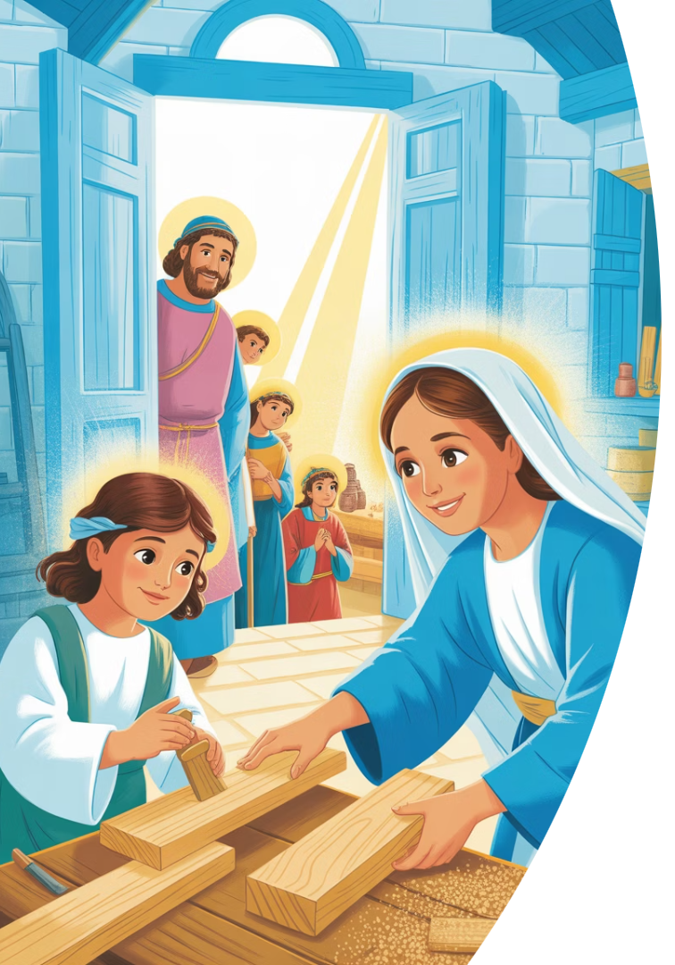



Mary, Strength of the Young
Creativity
Resilience
Tenderness
Our young people have gifts that often go unseen.
They endure hardship with remarkable strength.
Their capacity for compassion remains untarnished.

Slide 11








Mary, Mother of the Church
A Century of Prayer
Rising Again
A hundred years have passed in Awo Parish.
Let the Church rise from this soil with fire.
From Ashes
Our Prayer
From the ashes of war, raise up a choir of praise.
"Mary, rebuild your Church in us."

Slide 12
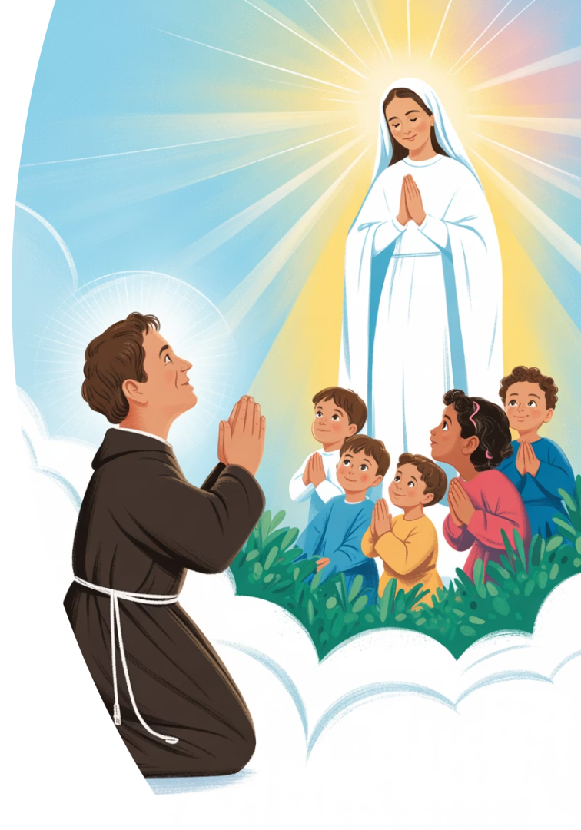
The Miracle of Presence
Don Bosco's Promise
"If you want to see miracles, trust in Mary."
Our Approach
We pray not as strangers, but as children.
The Greatest Gift
Your presence is the miracle we seek.

Slide 13
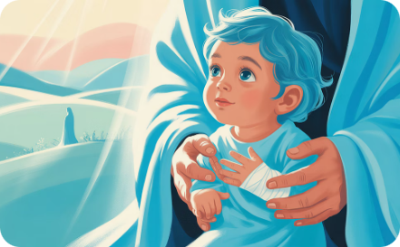
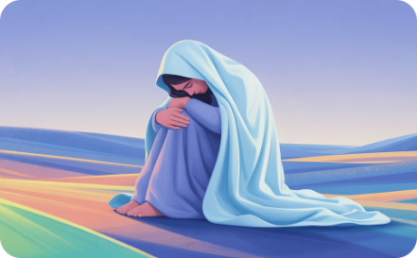
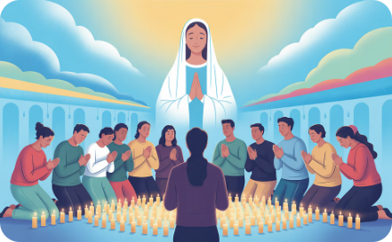
Day 1: Healing Wounds
Physical Healing
War leaves visible scars that need gentle care.
Emotional Healing
Trauma runs deep in hearts that have seen too much.
Communal Healing
Together, we find strength to face our collective pain.

Slide 14
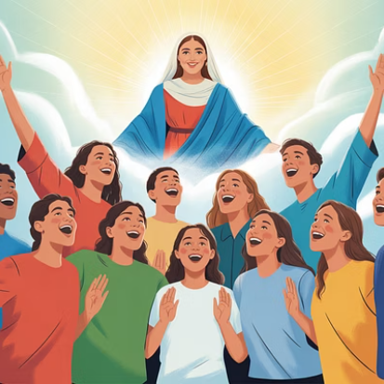
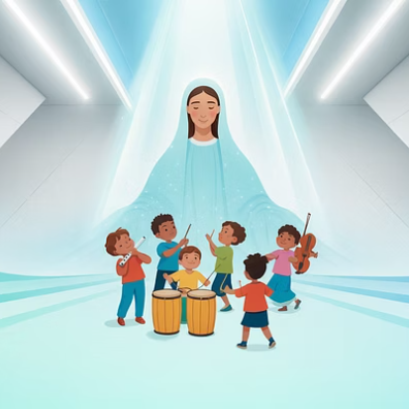
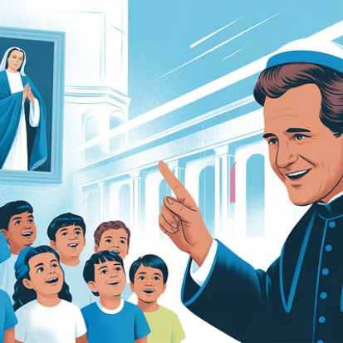
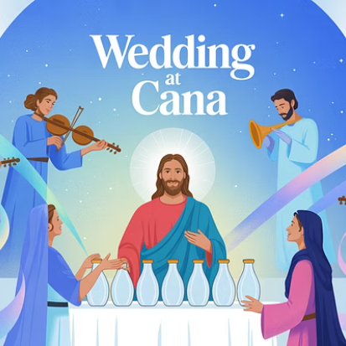
Day 2: Finding Music Again
"Mary, help us find the music in our souls again. Let our parish resound with songs of praise and healing."

Slide 15
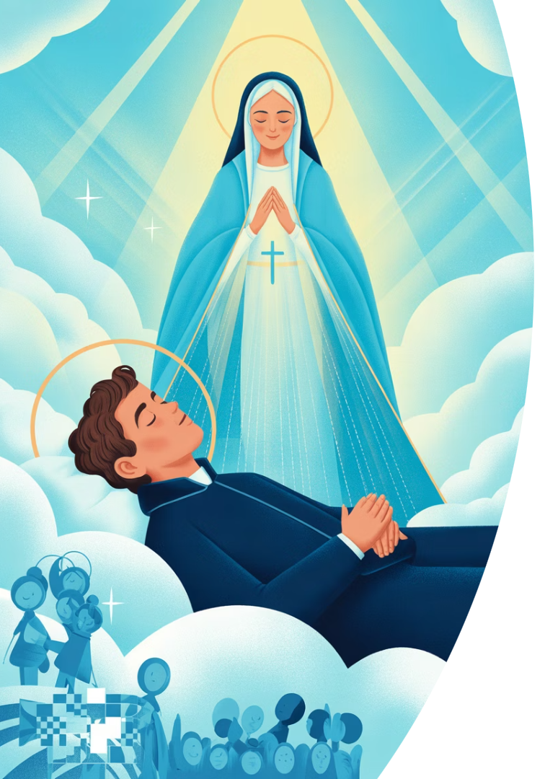
Day 3: Dreaming with Courage
3
9
Dreams of Don Bosco
Years of Dreaming
His prophetic visions guided his mission to the young.
From age nine, Don Bosco's dreams shaped his path.
1
Mother's Guidance
Mary appeared in his dreams, showing the way forward.

Slide 16
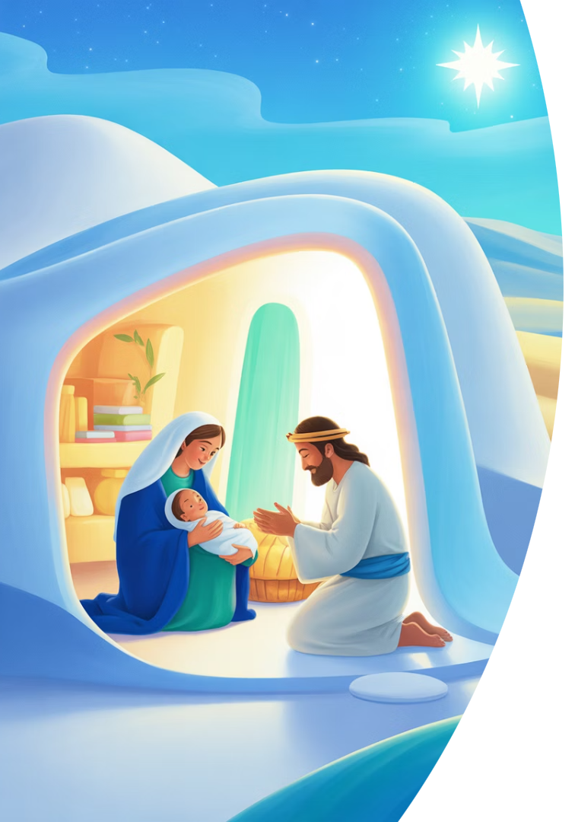
Day 4: Finding Home
Biblical Journey
Mary and Joseph's flight to Egypt with Jesus
Current Reality
Young people leaving in desperation
Don Bosco's Response
Creating homes where none existed
Our Prayer
"Mary, teach us to be home for others"

Slide 17




Day 5: Building the Oratory
Love
Prayer
Play
The foundation of Don Bosco's approach
Spiritual nourishment for young souls
Joy and recreation as essential elements
Education
Community
Developing minds and skills for life
Creating a sense of belonging
Don Bosco's Oratory balanced these essential elements. Love formed the foundation, supported by prayer, play, education, and community spirit.

Slide 18
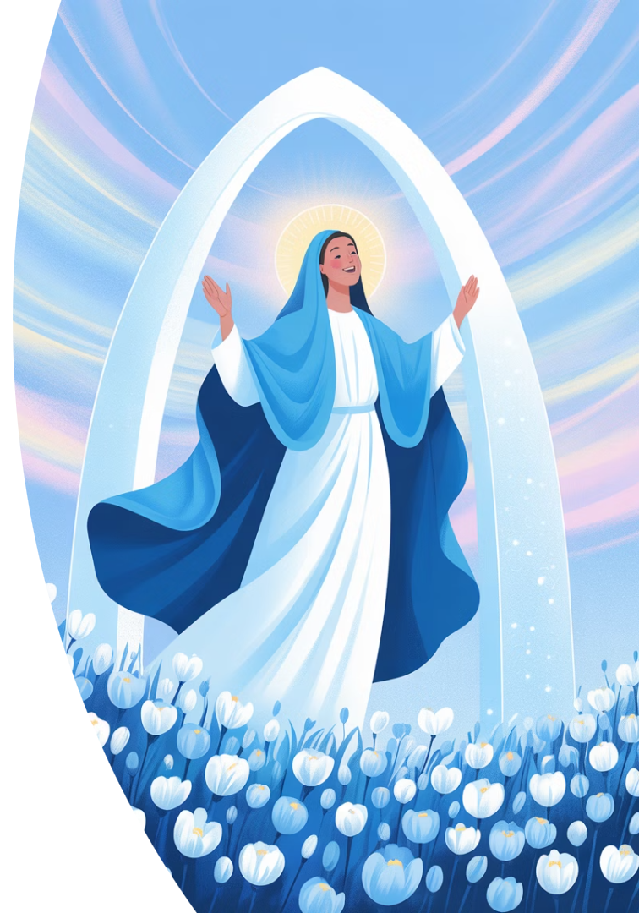




Day 6: Discovering True Joy
Mary's Magnificat
"My soul magnifies the Lord." Joy flows from gratitude.
Don Bosco's Wisdom
"Serve the Lord with gladness." Holiness and joy walk together.
Our Expression
In music, friendships, and worship, we find joy.
Our Prayer
"Mary, give us joy that depends on trust, not circumstances."

Slide 19
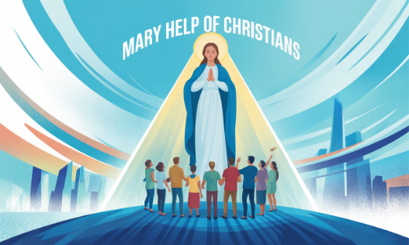
Day 7: Standing in Battle
Historical Protection
Our Current Need
Throughout history, Mary's intercession has protected communities during plagues and wars.
Today, we entrust the trauma of war to her protection.
We remember the ten young lives lost and ask her to stand at the gate of our hearts.
Don Bosco witnessed her power during cholera outbreaks and political turmoil.

Slide 20
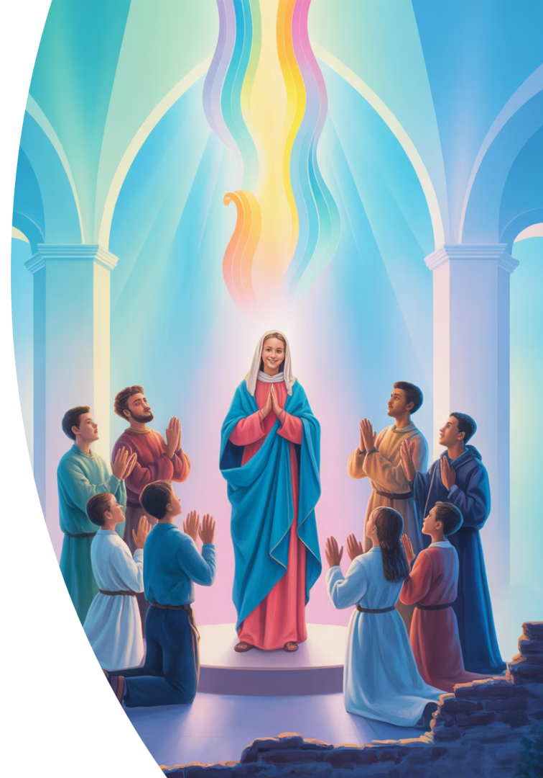



Days 8 & 9: Rebuilding the Church
Strength of the Young
Our young people have gifts that no one sees.
Like Don Bosco, we believe in them before they believe in themselves.
Power of Prayer
Mary gathered the apostles in prayer and waited for the Spirit.
A hundred years have passed in Awo Parish. And still, we pray.
Rising from Ashes
Let the Church rise from this soil again—not with prestige, but with fire.
From the ashes of war, raise up a choir of praise.

