Slide 1
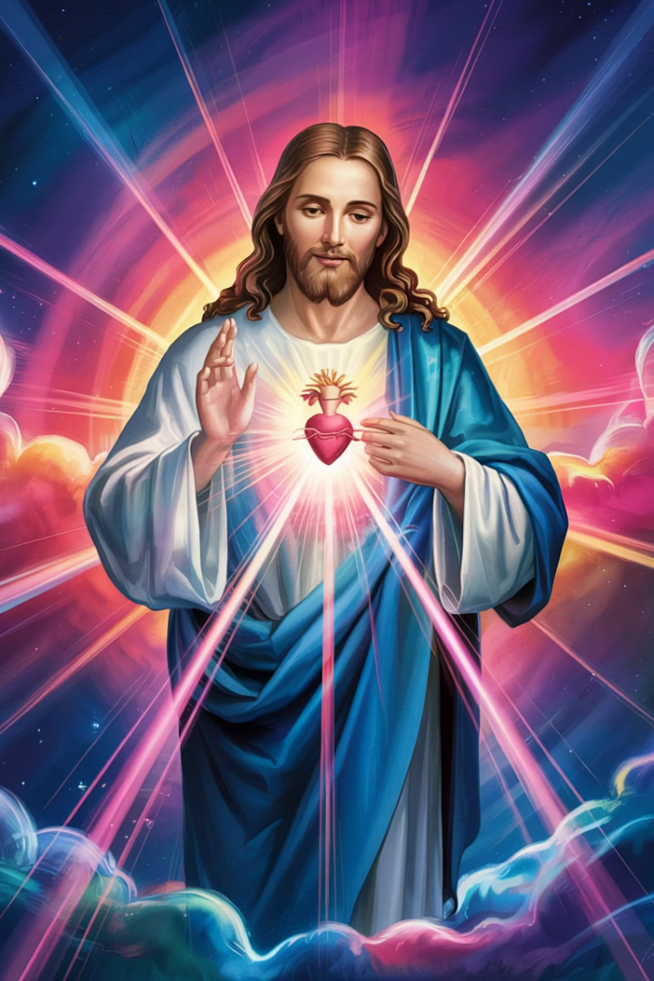
The Ocean Within: A Contemplation on Divine Mercy
Let us go deeper into the silent aching places of the soul, where God meets us not in thunder but in mercy. This is a descent into divine encounter, where our truth is met by God's unshakable tenderness.
by Abba Halibo

Slide 2




The Vastness of Divine Mercy
Recreates, Not Just Forgives
Descends Into Our Depths
Mercy so vast it doesn't simply forgive—it recreates us anew.
Divine Mercy descends into our cracks, rests in our silences.
Touches Hidden Wounds
It presses against the wounds that no one else sees.

Slide 3





The Divine Touch
Moves Past Defences
The Divine Touch penetrates our carefully built walls.
Through Denial
It cuts through our self-deception and pretense.
Beneath Performance
It reaches below our achievements and pride.
Finds the Naked Soul
It discovers us in our most naked, unedited state.

Slide 4
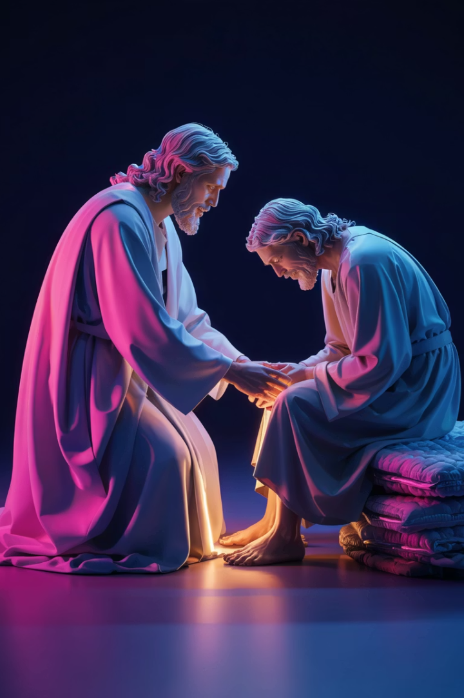
Where Mercy Kneels
Not to Judge
Divine Mercy comes not with condemnation but with compassion.
To Weep With Us
It joins us in our sorrow, validating our pain.
To Cleanse
It washes away the stains that we cannot remove ourselves.
To Awaken
It gently rouses us to a new awareness of divine love.

Slide 5
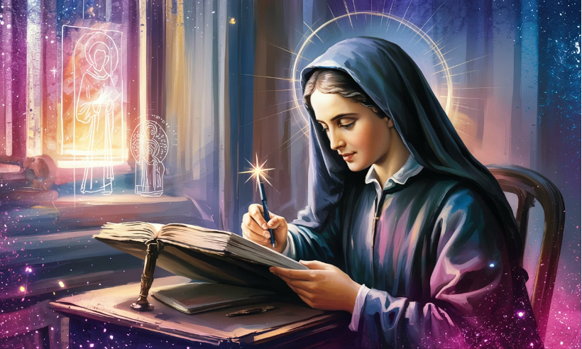
St. Faustina: Scribe of Mercy
Woman of Experience
St. Faustina was not a saint of theory. She was a woman of tears, silence, and visions.
Christ chose her to be the scribe of mercy, to tell the world that God is not indifferent to our agony.
She heard Christ's Heart speak not in abstraction, but in aching clarity.

Slide 6

The Words of Christ to Faustina
The Feast of Mercy emerged from My very depths of tenderness… Mankind will not have peace until it turns to the Fount of My mercy.
This "fount" is not merely sacramental—it is existential. It is Christ Himself: the open side, the pierced flesh, the bleeding mercy that calls the soul home.

Slide 7








Mercy's Existential Nature
Christ Himself
The embodiment of divine love
The Open Side
Vulnerability made sacred
The Pierced Flesh
Suffering transformed to healing
The Call Home
Invitation to divine intimacy

Slide 8
The Descent of Grace
Meeting Us Where We Are
1
God's willingness to encounter us in our darkest places
Entering Our Story
2
Mercy penetrates the narrative beneath our sins
Walking Through Memory
3
It traverses our past without recoiling

Slide 9





The Story Beneath the Sin
Childhood Grief
The sorrow that hardened into bitterness over time.
Abandonment
The rejection that froze into self-protection.
Unheard Cries
The pleas we made as children that no one answered.
Mercy's Response
Divine love that goes there, sees all, and does not turn away.

Slide 10

The Promise of Mercy
Let no soul fear to draw near to Me, even though its sins be as scarlet…
This is not mercy that tolerates brokenness. It seeks it out, longing to bring light to chambers where we've hidden even from ourselves.

Slide 11
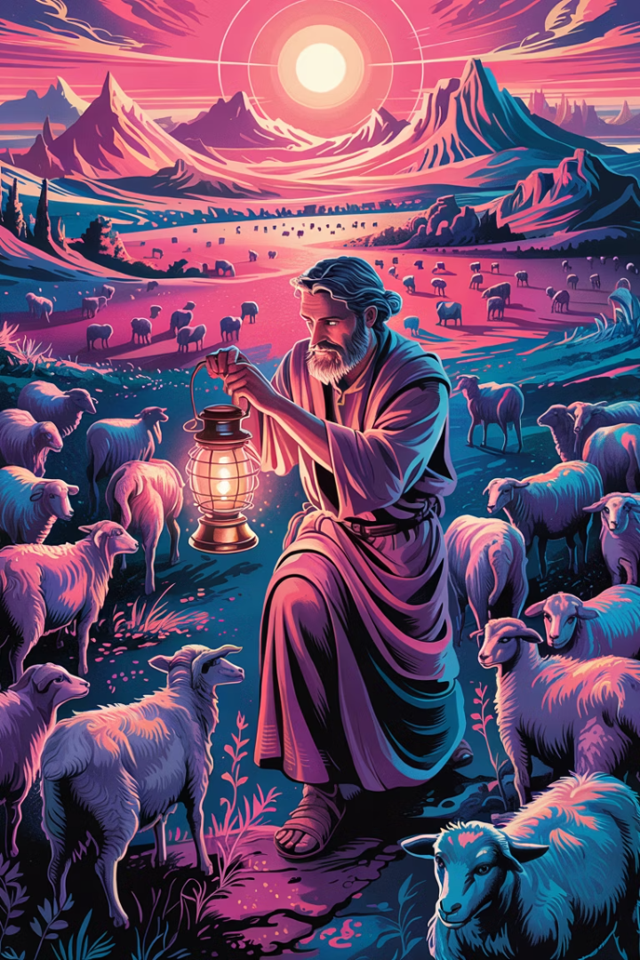



Mercy That Seeks
Actively Pursues
Divine Mercy doesn't wait passively—it actively seeks the lost.
Brings Illumination
It shines light into our darkest, most hidden places.
Unlocks Hidden Chambers
It opens doors within us that we've kept locked for years.

Slide 12




The Soul as Sacred Terrain
There are regions within us so tender that we instinctively guard them with silence. Divine Mercy is not a trespasser. It waits with unspeakable patience.
Sacred Heights
Guarded Gardens
Patient Presence
Sacred Encounter
The elevated regions of our souls where we experience transcendence and divine encounter.
The tender spaces within us that we protect with silence, waiting for safe revelation.
Divine Mercy waiting at the threshold, never forcing entry but present with unspeakable patience.
The moment when we allow Divine Mercy to enter our most guarded inner sanctuaries.

Slide 13



The Patient Waiting
Outside Locked Doors
Unspeakable Patience
Gentle Invitation
Divine Mercy waits at the threshold, never forcing entry.
It remains present through years of our resistance and fear.
It knocks softly, offering relationship rather than demanding it.

Slide 14








The Soul's Whisper
Opening Slightly
Tentative Trust
The soul begins to lower its defenses
"Jesus, if You still want me..."
Flood of Grace
Mercy's Entrance
Almost unbearable in its tenderness
He enters with gentleness, not rebuke

Slide 15
The Gentle Restoration
Not Erasure
Restoration
He does not erase what we are. Our experiences and journey remain part of us.
He restores what we forgot we were. Our original dignity and beauty are unveiled.
Our wounds become sacred places of encounter, not shameful scars to hide.
We begin to see ourselves through His eyes—beloved, worthy, and infinitely precious.

Slide 16

Beyond Forgiveness
More Than Pardon
Reintegration
We often reduce mercy to pardon. But Divine Mercy wants more for us.
It desires to reintegrate, to bring home every scattered fragment of who we are.
Wholeness
It wants the soul not just forgiven, but whole.

Slide 17




Transformational Mercy
Not Transactional
Not a simple exchange of sin for forgiveness
Transformational
A complete renewal of the inner person
New Perspective
Seeing ourselves through God's loving gaze

Slide 18
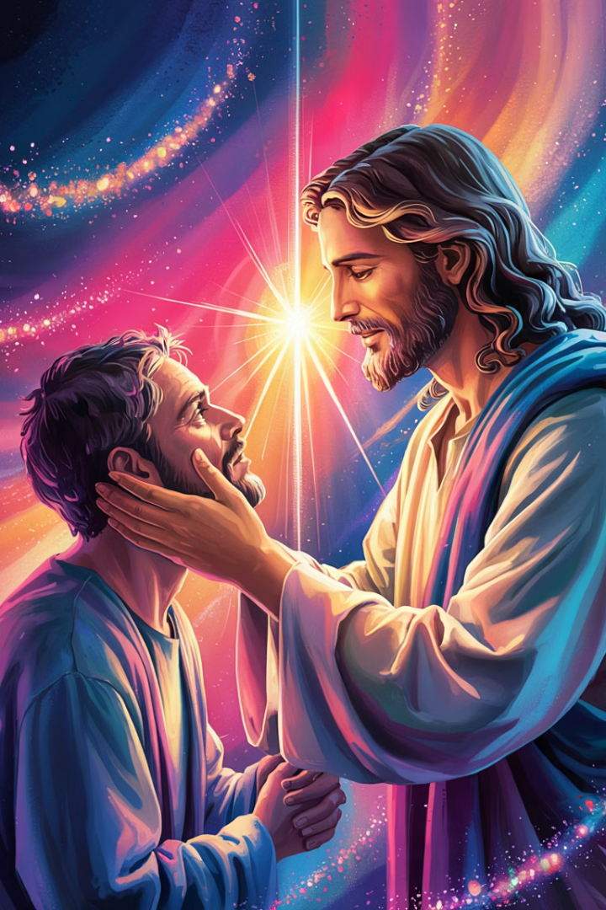
The Divine Gaze
You are not your worst moment. You are not your lifelong wound. You are not your silence. You are Mine.
This is the gaze that defines us not by our failures or wounds, but by our belonging to God.

Slide 19




A Living Sanctuary
Sanctuary of Presence
Not of perfection, but of divine indwelling
Heart Expansion
Growing capacity for love and compassion
Softened Gaze
Seeing others through mercy's lens
Transformed Suffering
Pain becomes a place where Love reveals itself

Slide 20




Changed by Mercy's Touch
Inner Transformation
When Divine Mercy touches a soul, that person becomes changed—not always immediately, but profoundly.
Living Differently
You begin to live differently, not by effort, but by indwelling.
Becoming a Vessel
The soul becomes a channel through which mercy flows to others.

Slide 21








Living by Indwelling
Divine Residence
Heart Transformation
God makes His home within us.
Our desires align with His.
Natural Outflow
Inner Peace
Good works flow from presence, not effort.
Resting in divine acceptance.

Slide 22



The Whisper of Trust
Words of Surrender
Faustina's Legacy
The Ultimate Trust
The soul begins to whisper—sometimes with words, sometimes with silence.
What Faustina wrote with her life becomes our own prayer.
"Jesus, I trust in You" becomes not just words but a way of living.

Slide 23

The Prayer of Trust
Jesus, I trust in You.
These five words contain a universe of surrender, hope, and relationship. They acknowledge both our need and His sufficiency.

Slide 24



Mercy's Invitation to the Hidden Places
Go Where I Cannot
Enter the Unlit Rooms
Speak to Hidden Places
Jesus, Divine Mercy—Go where I do not know how to go.
Enter the rooms within me that remain unlit.
Speak into the places I have kept hidden, even from You.

Slide 25
The Prayer for Mercy's Dwelling
More Than Cleansing
Deep Indwelling
Let Your mercy not only cleanse me, but claim me.
Dwell in the marrow of my soul.
Let it become my resting place, my beginning again.
Let every breath echo: Jesus, I trust in You.

Slide 26




The Mercy That Recreates
Brokenness
Divine Touch
Our fragmented, wounded state
Mercy encounters our wounds
Recreation
Healing
We become new, yet fully ourselves
Restoration begins within

Slide 27


The Descent of Divine Mercy
From Heaven to Earth
Mercy bridges the divine and human realms
Into Human Experience
Christ enters our suffering completely
To the Soul's Depths
3
Mercy reaches our most hidden places

Slide 28



Mercy in the Cracks
Finding the Openings
Beauty in Brokenness
Persistent Love
Divine Mercy slips into the smallest openings in our defenses.
Our very wounds become channels for grace to enter.
Nothing can ultimately prevent God's mercy from reaching us.

Slide 29
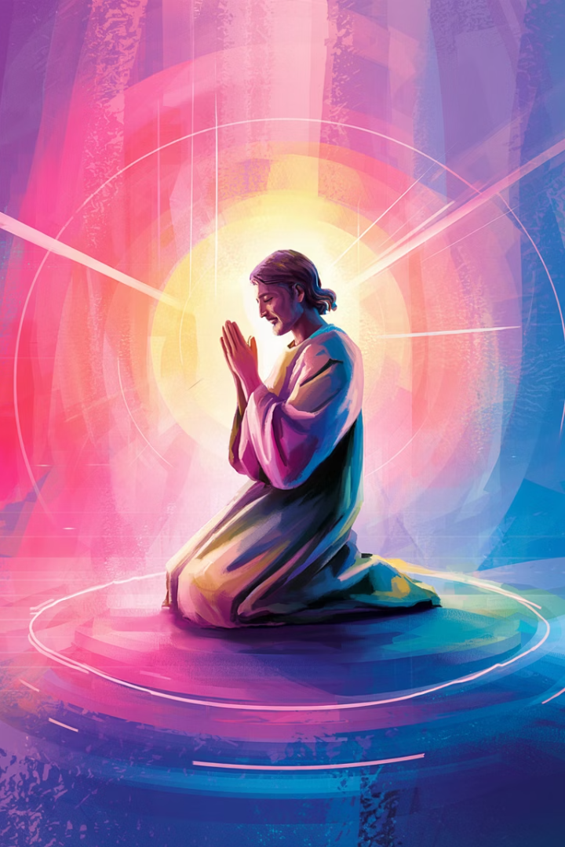
Mercy in the Silences
Beyond Words
Unspoken Pain
Divine Mercy rests in the silences where words fail us.
It meets us in griefs too deep for expression.
Wordless Communion
It creates space for presence beyond language.

Slide 30
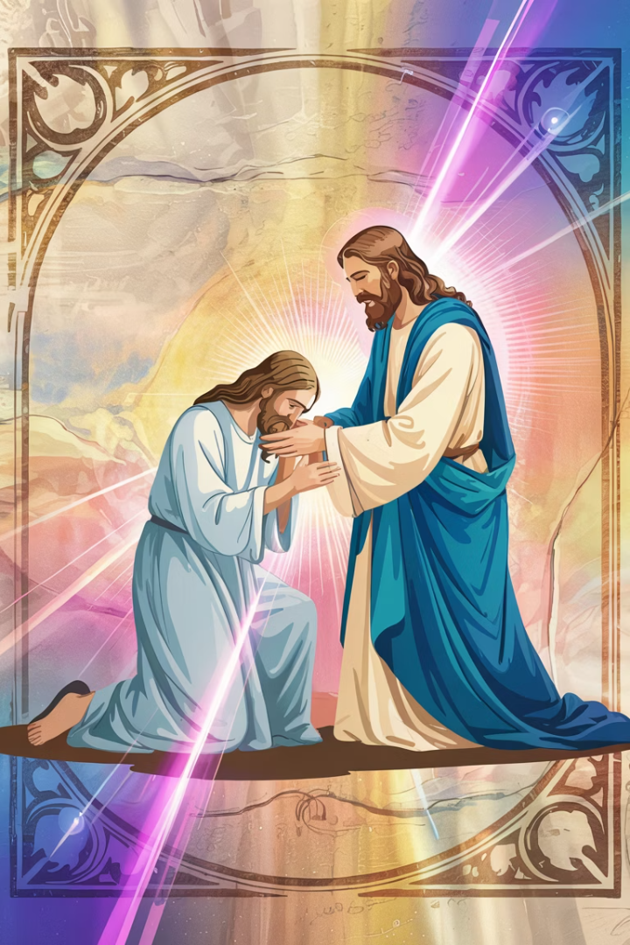




Mercy Against Hidden Wounds
Invisible Injuries
Wounds that others cannot see shape our inner landscape.
Divine Recognition
Mercy acknowledges pain that has gone unwitnessed.
Gentle Application
It presses healing balm against our most tender places.
Sacred Scars
Our healed wounds become testimonies to divine tenderness.

Slide 31
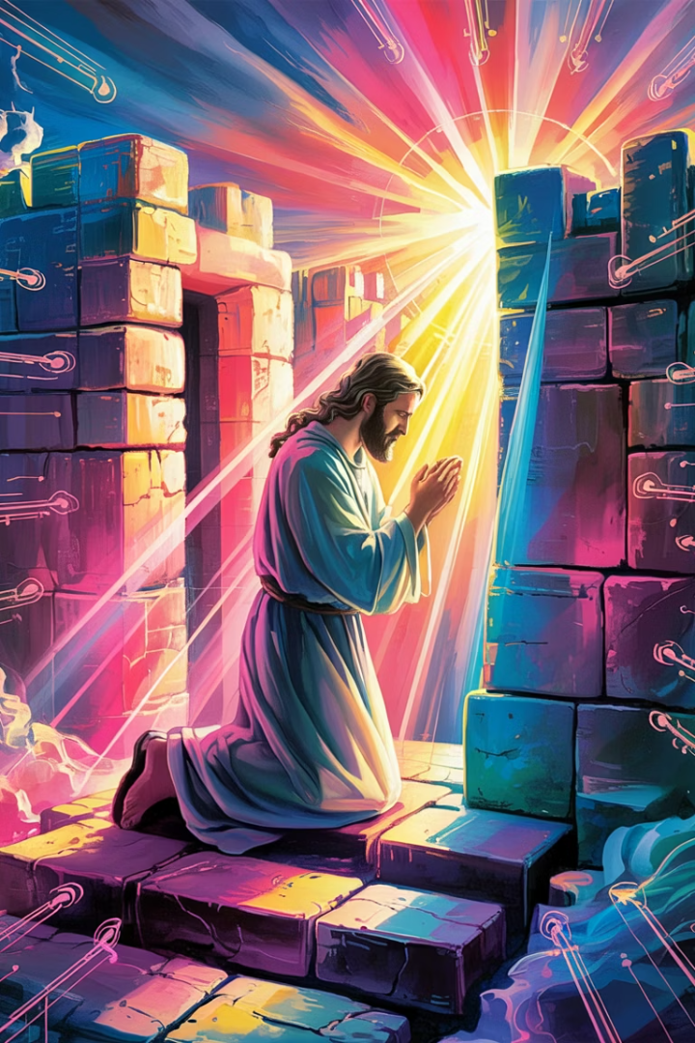
The Divine Touch Beyond Defenses
The Divine Touch moves past our carefully constructed defenses, through our denial, beneath our performance and pride.

Slide 32
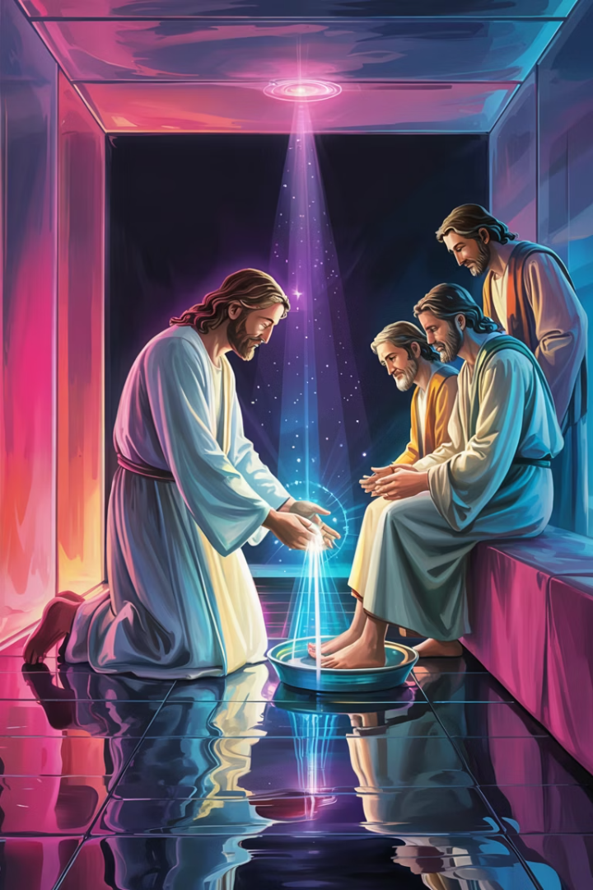




Mercy That Kneels
Divine Humility
Compassionate Presence
Cleansing Love
God stoops to our level in an act of profound humility.
It washes away what we cannot cleanse ourselves.
Mercy weeps with us in our sorrow and confusion.
Awakening Touch
It gently rouses us to new life and possibility.

Slide 33
St. Faustina: Witness of the Abyss
Woman of Experience
Scribe of Mercy
St. Faustina was not a saint of theory. She was a woman of tears, silence, and visions.
Christ chose her to be the scribe of mercy, recording His messages in her diary.
Her encounters with Christ were deeply personal and transformative.
Her writings reveal that God is not indifferent to our agony.

Slide 34



The Heart of Christ Speaking
Not Abstract Theology
Recorded Revelations
She heard Christ's Heart speak not in abstraction, but in aching clarity.
Her diary captures the intimate conversations between Jesus and her soul.
Message for Humanity
These private revelations were meant to be shared with all people.

Slide 35

The Feast of Mercy
The Feast of Mercy emerged from My very depths of tenderness… Mankind will not have peace until it turns to the Fount of My mercy.
This feast, now celebrated as Divine Mercy Sunday, offers special graces to those who approach with trust.

Slide 36



The Fount of Mercy
The Open Side
Sacramental Grace
Personal Encounter
From Christ's pierced heart flows the sacramental life of the Church.
The Eucharist and Confession are privileged channels of mercy.
Each soul can drink directly from this fountain of grace.

Slide 37

Mercy Meeting Us Where We Fear
Willingness of God
Beyond the Sin
What is mercy if not the willingness of God to meet us exactly where we dare not go?
He enters not only the sin, but the story beneath the sin.
Into Our Architecture
Mercy walks through memory, through the architecture of pain, and does not recoil.

Slide 38





The Story Beneath Our Sins
Childhood Grief
The grief that hardened into bitterness
Abandonment
The rejection that froze into self-protection
Unheard Cries
The pleas we made that no one answered
Mercy's Response
Divine understanding that sees the whole story

Slide 39


Tender Regions of the Soul
Guarded Places
Divine Patience
Areas we protect with silence
Mercy waits outside locked doors
Grace's Response
4
Soul's Invitation
3
Gentle flood of divine tenderness
Our tentative opening to grace

Slide 40

Beyond Forgiveness to Wholeness
Pardon
We often reduce mercy to pardon—the wiping clean of sin's slate.
Reintegration
Divine Mercy desires to reintegrate, bringing home every scattered fragment of who we are.
Wholeness
It wants the soul not just forgiven, but whole—fully alive in all dimensions.

Slide 41

The Transforming Gaze
You are not your worst moment. You are not your lifelong wound. You are not your silence. You are Mine.
This gaze of belonging redefines us beyond our failures, wounds, and inadequacies.

Slide 42








The Sanctuary of the Soul
Divine Indwelling
We live by God's presence within.
Expanded Heart
Our capacity for love grows.
Suffering Transformed
Profound Change
Mercy's touch transforms us deeply.
Pain becomes a place of divine revelation.

Slide 43
The Soul's Sanctuary
Not of Perfection
Of Divine Presence
The soul becomes a sanctuary, not of perfection, but of Presence.
God makes His dwelling within us, transforming us from within.
We remain human, with limitations and struggles, yet divinely inhabited.
Our very being becomes sacred space where heaven and earth meet.

Slide 44

The Whisper of Trust
Beginning Expression
The soul begins to whisper—sometimes with words, sometimes with silence.
Faustina's Legacy
What Faustina wrote with her life becomes our own prayer.
Simple Surrender
Five words contain a universe of relationship: "Jesus, I trust in You."

Slide 45

A Final Prayer from the Depths
Jesus, Divine Mercy— Go where I do not know how to go. Enter the rooms within me that remain unlit. Speak into the places I have kept hidden, even from You. Let Your mercy not only cleanse me, but claim me. Let it become my resting place, my beginning again. Dwell in the marrow of my soul. Let every breath echo: Jesus, I trust in You.

