Slide 1
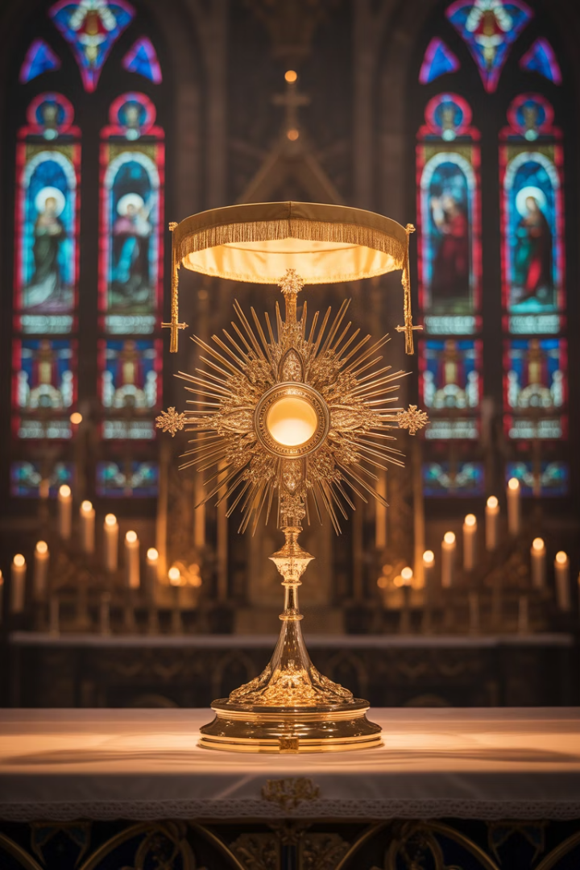
Holy Hour Before the Blessed Sacrament
We enter the chapel. Silence holds the space. There He is hidden, exposed, waiting in the Consecrated Host. We come not because we are worthy, but because we are hungry.
by Abba Halibo

Slide 2
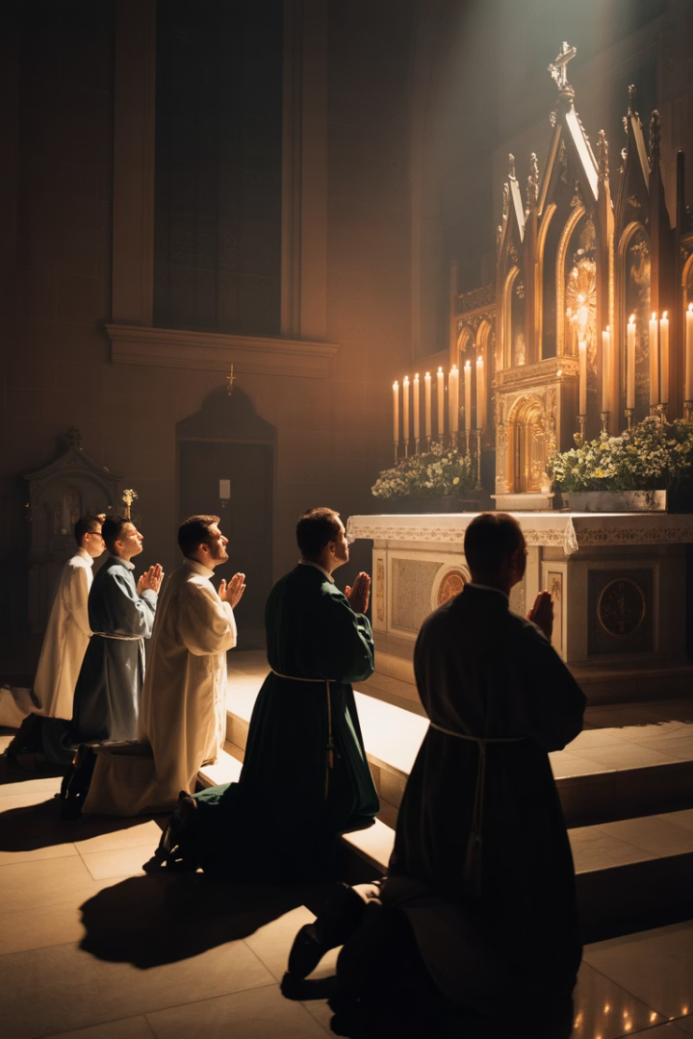
The Invitation to Worship
"Come, let us bow down in worship, let us kneel before the Lord our Maker; for he is our God and we are the people of his pasture." (Psalm 95:6–7)
A Call to Presence
A Place of Belonging
We are invited into sacred communion. Not as strangers, but as His beloved flock.
Here in His presence, we find our true home. The pasture where our souls can rest.
A Moment of Encounter
We bow not from obligation, but from recognition. Our Maker awaits our company.

Slide 3






The Gaze of Mercy
Love That Chooses
We are known. Deeply. Unflinchingly. And yet, still chosen.
Being Truly Seen
He sees past our shame, through our confusion, beneath our distractions.
Where Masks Fall
This is not a place of performance. This is where pretense dissolves.
We bow and worship not because we understand everything, but because He understands us. His gaze never wounds—it heals.

Slide 4
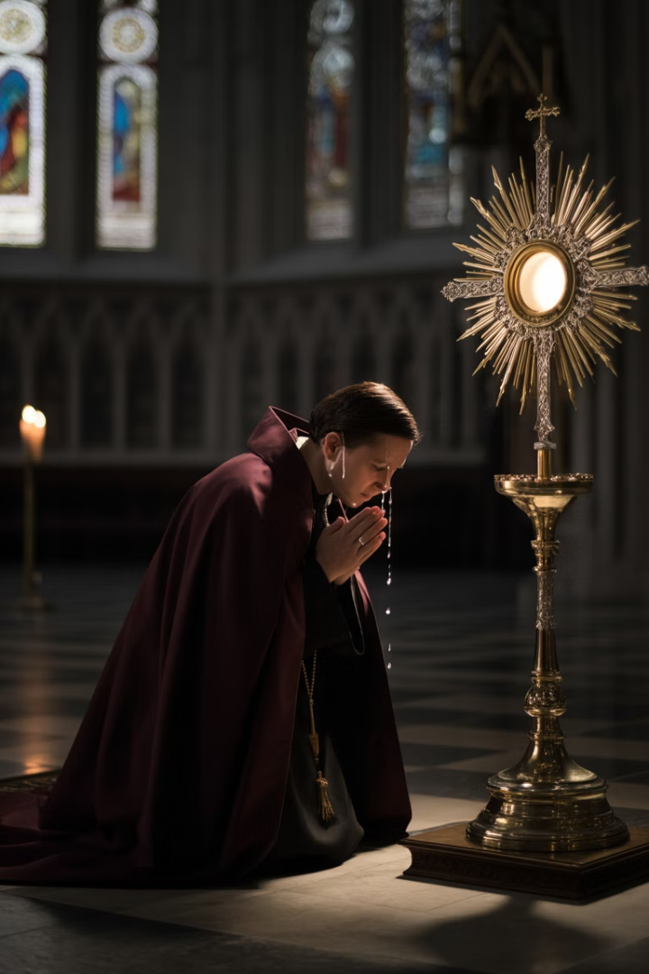




A Lived Encounter of Grace
Entering the Chapel
We come bearing our burdens, hopes, and failures.
Embracing Silence
Our busy minds gradually still in His presence.
Receiving Grace
Something within us yields to His gentle invitation.
Transformation Begins
We leave different than when we arrived.

Slide 5
The River of Grace
Unseen Movement
Mercy's Transforming Touch
In the quiet, there is a movement. Like a river running deep beneath the still earth.
Grace softens the heart. It unfreezes old pain.
It releases bitterness we forgot we were carrying. Here, we don't need to fix ourselves.
This flow of grace is gentle yet powerful. It works in ways we cannot fully comprehend.
We only need to be present.

Slide 6
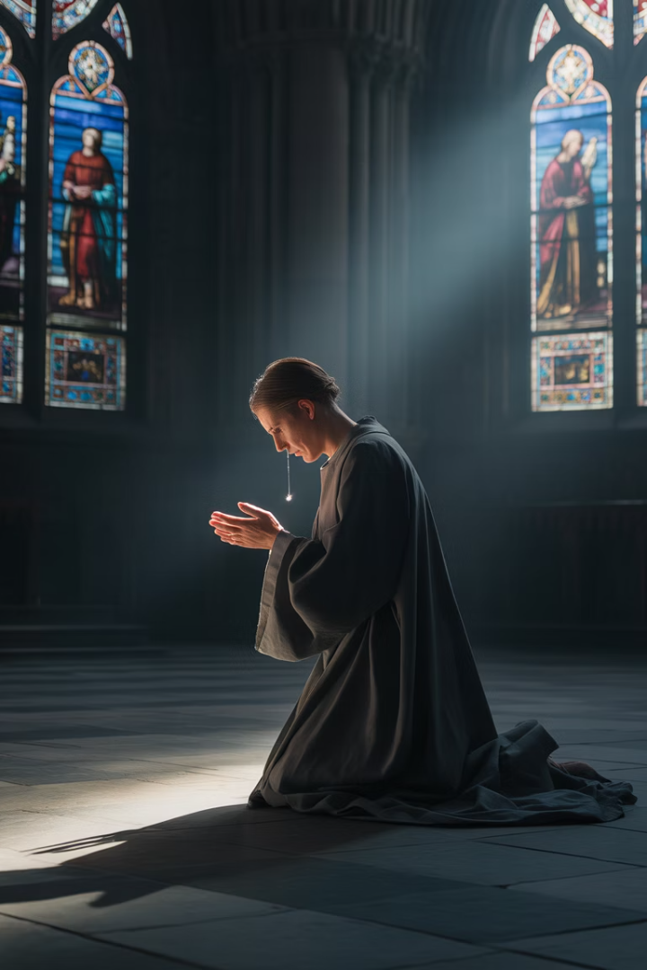




Mercy in Motion
Cleansing Our Wounds
Mercy washes over places we've kept hidden, even from ourselves.
Renewing Our Hope
In this sanctuary of grace, our deepest yearnings find voice again.
Unlocking Our Chains
Hurts we've carried for years begin to lose their grip in His presence.
Lifting Our Burdens
We come heavy-laden. We leave with lightness we cannot explain.

Slide 7
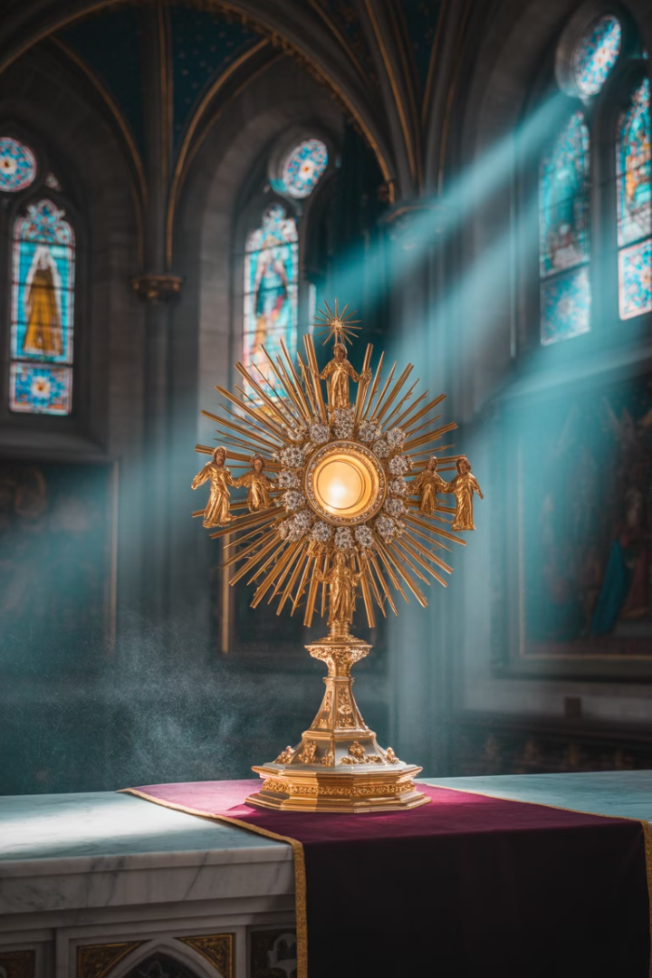
The Weight of Glory
Meeting Truth Incarnate
Before the Blessed Sacrament, we don't just meet silence—we meet Truth. Not an idea, but a Person.
Surrendering Control
To worship here is to say: "I don't need to control this moment. I belong to something greater."
Offering Our Whole Selves
We bring our doubts, hopes, fears, and flaws and lay them at His feet.

Slide 8








A Truth That Holds Us
His Majesty
His Humility
We encounter the King of the Universe hidden in simple bread.
The God who made all things makes Himself small enough to be received.
Our Response
His Love
We bow in awe of a love that holds everything.
Love beyond understanding that continues to give itself completely.

Slide 9
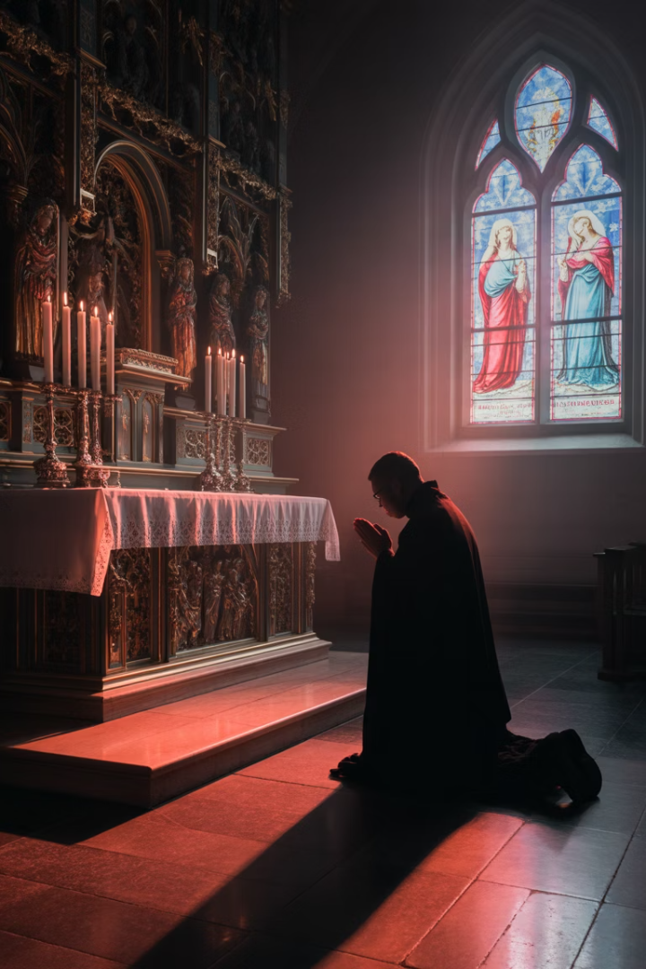



The Deep Within
Beyond Words
Where Wounds Dwell
There is a place in each of us where words fail.
Our most tender places, too deep for casual sharing.
Soul's Awakening
In adoration, that hidden place is touched.
The soul stirs. Tears may come, or just deep stillness. And we realize: this is what we were made for.

Slide 10
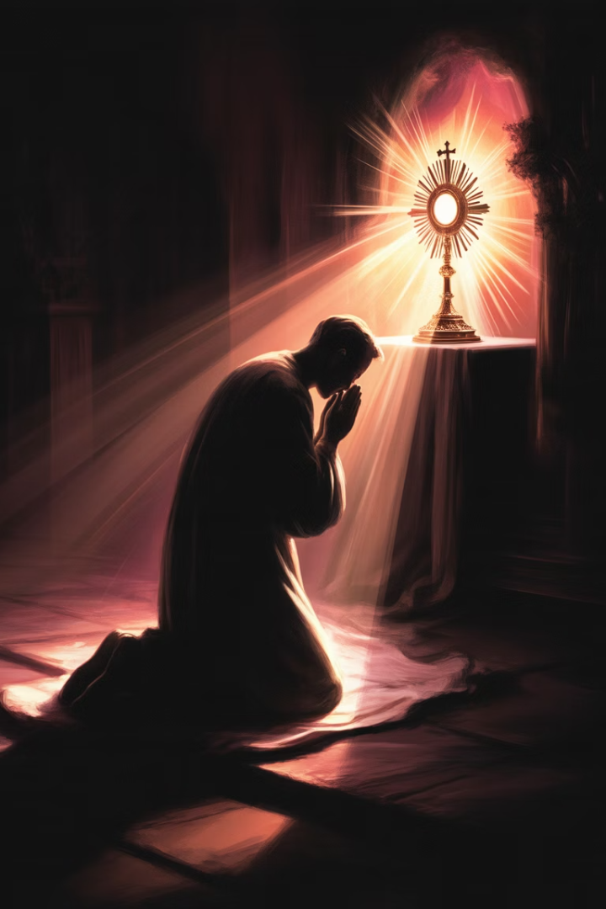



Soul Meeting Mystery
The Eloquence of Silence
The Gift of Holy Tears
The Wisdom of Surrender
Sometimes worship moves beyond words to the language of weeping.
Not just to think, but to bow. Not just to believe, but to adore.
In the quiet, God speaks to hearts that have learned to listen.

Slide 11
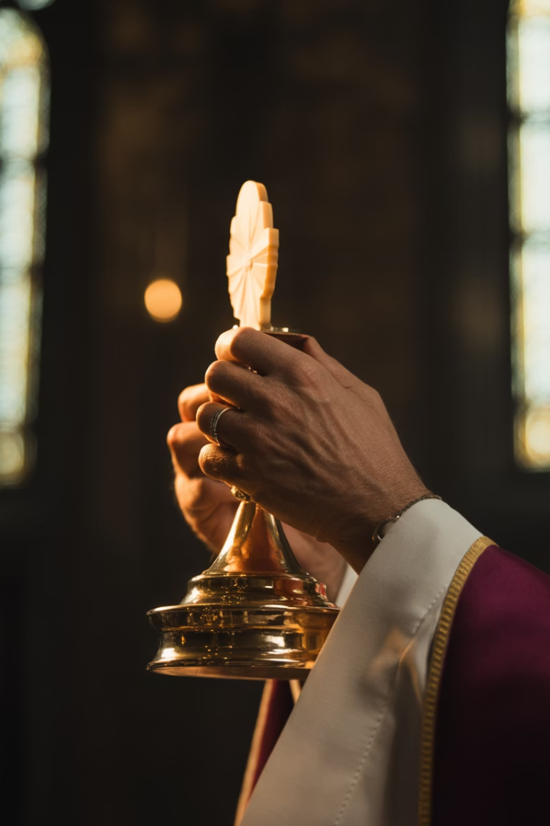
This is My Body
"This is my Body... given for you." (Luke 22:19)
33
3
Years on Earth
Hours on Cross
His entire earthly life, poured out in love.
His suffering, present in the Eucharist.
1
Eternal Gift
The sacrifice that transcends all time.

Slide 12
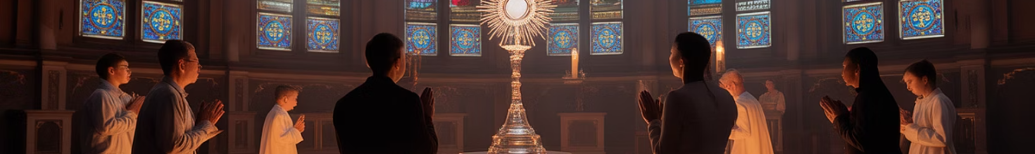




Worship as Meaning
Reorientation
To worship is to reorient our whole being toward what is true and beautiful.
Finding Our Place
We are not the center. But we are held by the One who is.
Entering The Story
In the Eucharist, the whole story of salvation is present.
The Paradox
Only in giving ourselves do we truly receive.

Slide 13
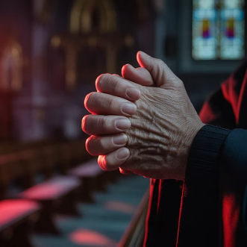
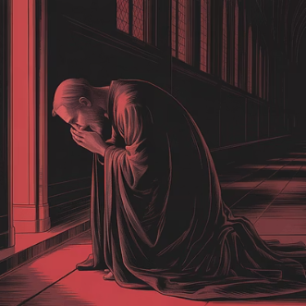
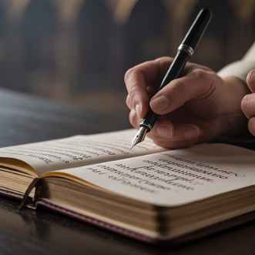
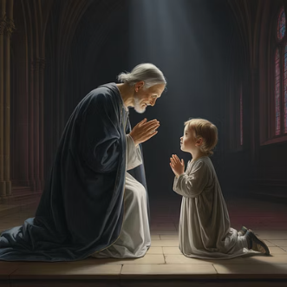
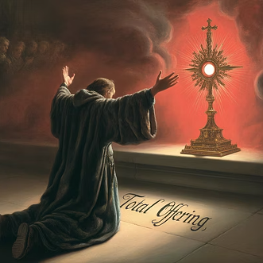
Giving Ourselves to What Matters
Every posture of the body can become a language of the heart. Our physical surrender mirrors our spiritual offering.

Slide 14
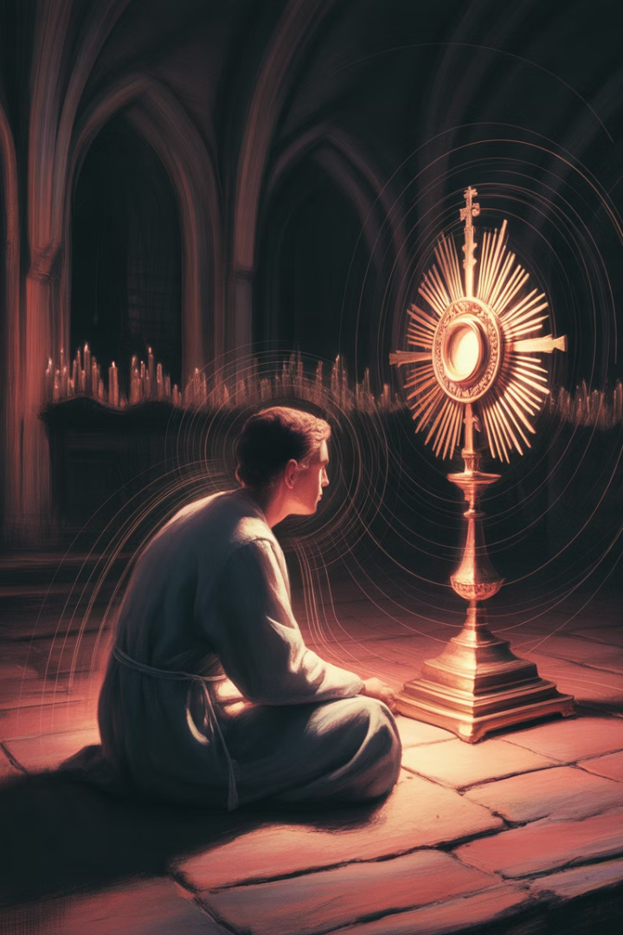
The Invitation to Remain
"Remain with Me"
"Abide in My Love"
Christ's invitation echoes from Gethsemane to our hearts today. He longs for our companionship.
Not just a momentary visit, but a dwelling place. A home for our restless souls.
"Do this in Memory of Me"
Each moment in adoration fulfills His request at the Last Supper. We remember actively, lovingly.

Slide 15
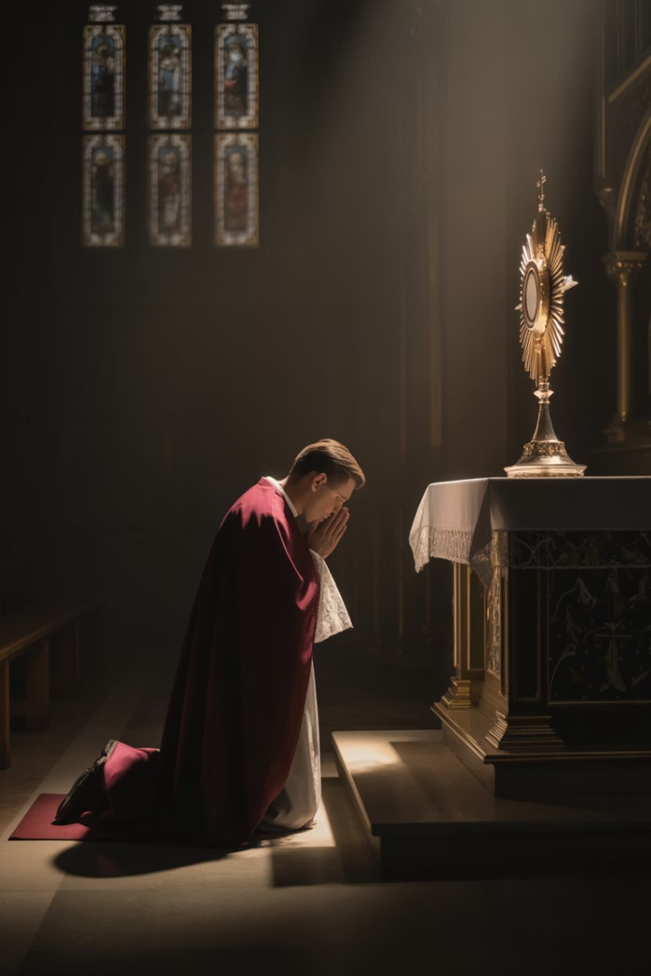










Silent Prayer
Resting
Listening
Finding peace in His presence
Attuning our hearts to the still, small voice
Gazing
Contemplating His beauty and truth
Weeping
Tears that speak when words cannot
Offering
Presenting ourselves as living sacrifices
Let us be still now in front of the One who is never in a hurry, who knows how to wait, who longs to dwell with us.

Slide 16
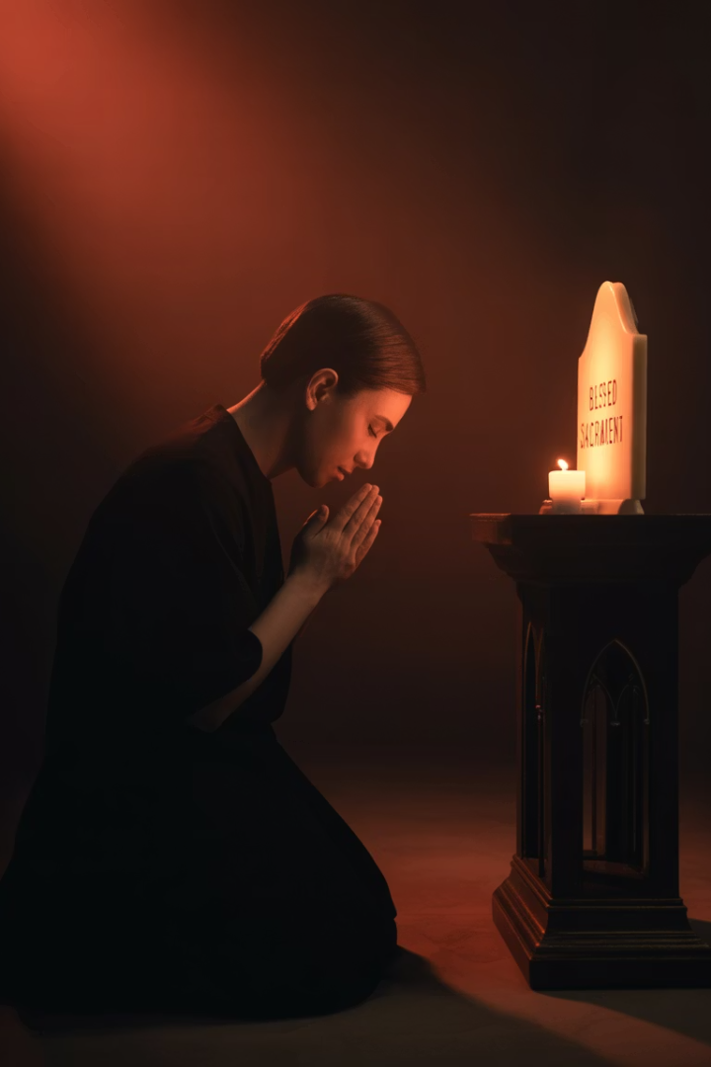
The Breath of Prayer
Inhale
"Lord Jesus Christ"
Exhale
"Son of God"
Inhale
"Have mercy on me"
Exhale
"A sinner"
Let every breath be a prayer. Let every heartbeat echo His mercy. Let every silence be filled with His Word.

Slide 17
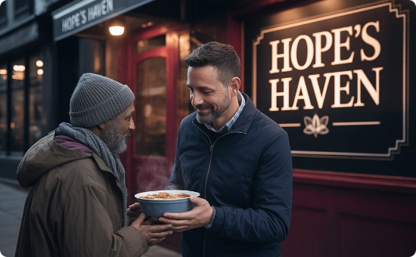
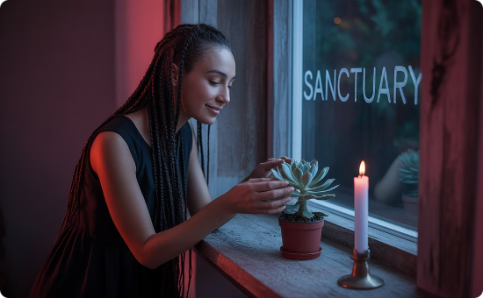
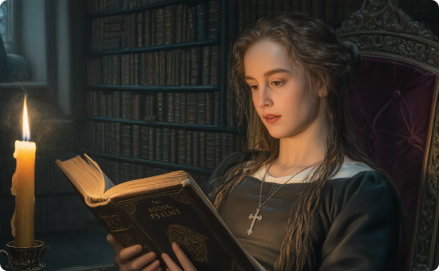
The Fruits of Adoration
Greater Charity
Inner Peace
Spiritual Clarity
Time spent beholding Love incarnate overflows into how we treat others.
His presence continues within us, bringing calm to life's storms.
Eyes that gaze upon the Host see more clearly in all aspects of life.

Slide 18







Let Us Bow and Worship
As Sinners
As Subjects
Bringing our brokenness to the Divine Physician.
Recognizing His sovereignty over our lives.
As Children
As Friends
With simple trust and wonder, knowing we are loved.
Invited into intimate communion with our Creator.
2

Slide 19
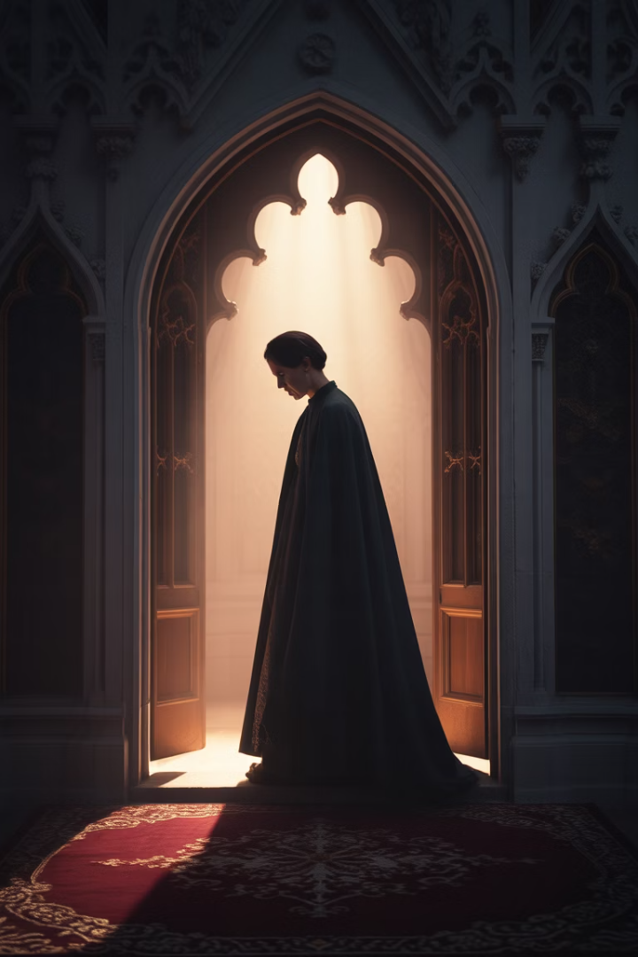
A Lived Encounter
1
Come As You Are
Bring your whole self—joys, wounds, questions, and hopes.
2
Be Present
Release distractions. Focus on the One who is truly present.
3
Receive
Open yourself to grace. Let Love look upon you and transform you.
4
Carry His Presence
Let this encounter shape how you live and love beyond the chapel.

Slide 20
Grace and Meaning
Our Beginning
Our Journey
Our Destination
We were made for communion with God. The Eucharist fulfills our deepest purpose.
Each Holy Hour shapes us. We become what we behold.
What begins in the chapel culminates in heaven. Eternal adoration.
This quiet revolution transforms souls. One act of adoration at a time.
We practice now what will be our eternal joy. Face to face with Love itself.
In His presence, we discover who we truly are. Beloved children. Living tabernacles.

