Slide 1

Pentecost: A Deep Meditation on Being Touched by the Holy
A journey through the transformative power of the Holy Spirit, exploring how divine presence shapes our inner lives and relationships.
by Abba Halibo -

Slide 2
Gathering Silence
The Still Room of the Heart
Picture yourself in that upper room. An ordinary place made sacred by waiting hearts.
"When Pentecost day came round, they had all met in one room..." (Acts 2:1)
Something in you aches, but you don't know what for. You are suspended in that space.
Come into the stillness. Let your body settle. Let your inner voices quiet.

Slide 3
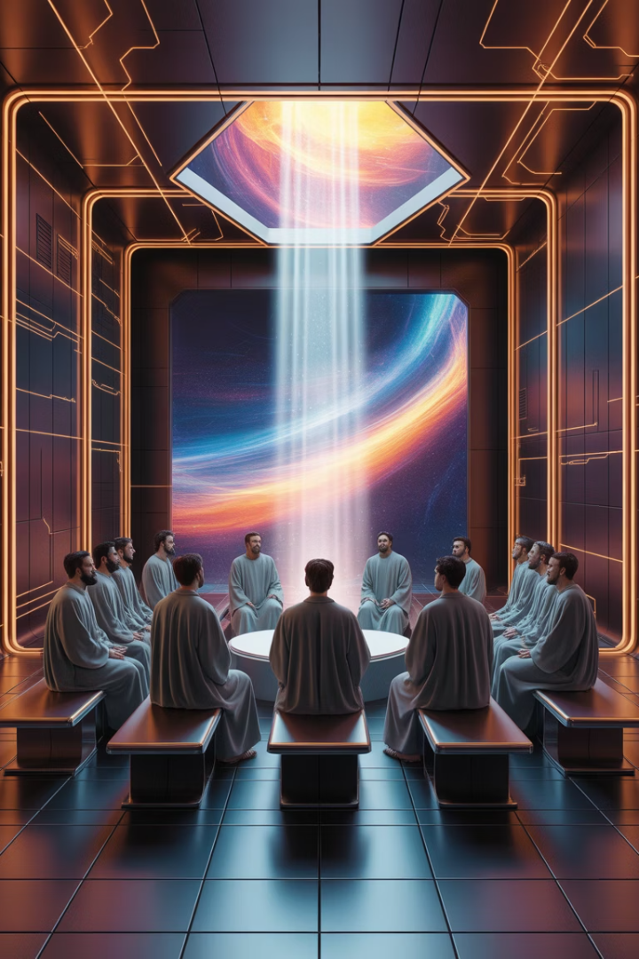



The Space Between
Suspended Moments
Sacred Waiting
We often find ourselves between "already" and "not yet".
The waiting itself becomes our prayer.
Inner Preparation
Silence creates space for divine encounter.

Slide 4
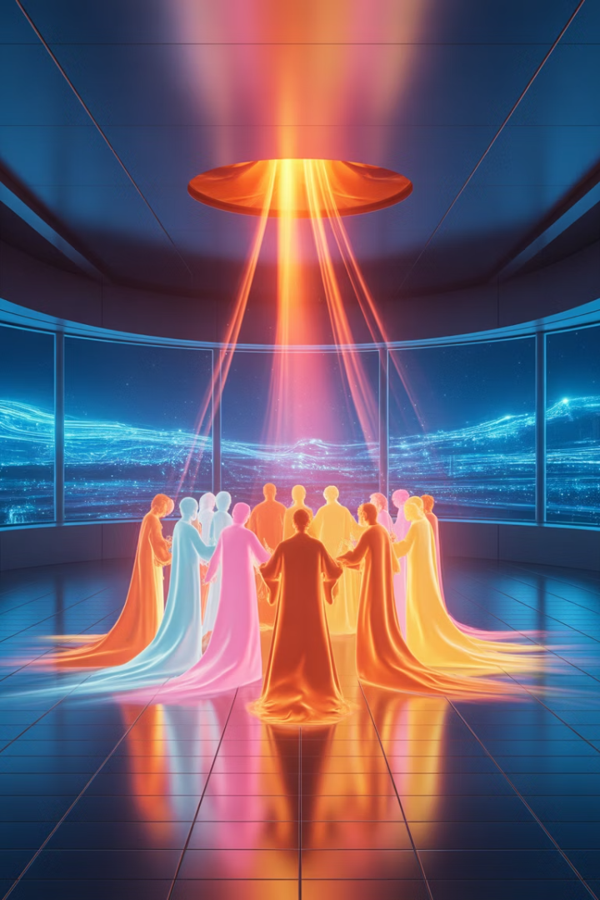
The Coming
Divine Disruption
Holy Transformation
"Suddenly there came from heaven a sound as of a violent wind..."
The Spirit breaks in, not to destroy, but to open.
Uncontrollable Presence
A wind you cannot control. A fire you cannot tame.

Slide 5




Unexpected Awakenings
Sudden Clarity
Moments when understanding breaks through like dawn.
Deep Stirring
A trembling in the soul that wasn't there before.
Divine Touch
"This is not from me, but it is deeply part of me."

Slide 6




Pathways of the Spirit
Through Disruption
Through Beauty
Through Silence
When comfort is shaken, new growth begins.
When wonder opens the heart to deeper truth.
When stillness speaks louder than words.

Slide 7
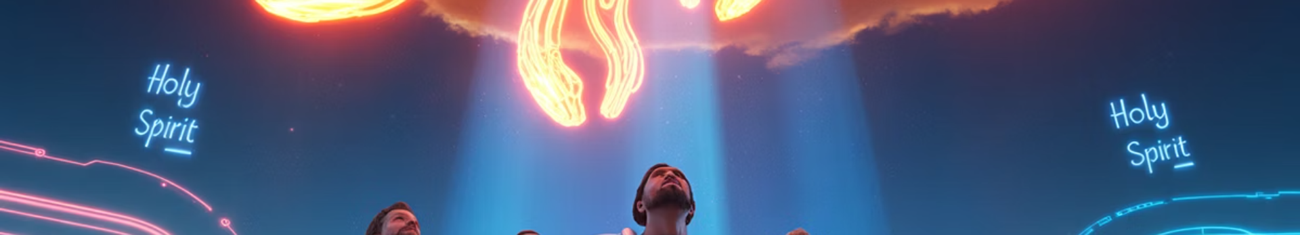



Tongues of Fire
Divine Expression
"They began to speak in different languages as the Spirit gave them power."
Heart Language
Each person heard in the language of their heart.
Authentic Voice
Being transparent to something more loving than your usual self.

Slide 8
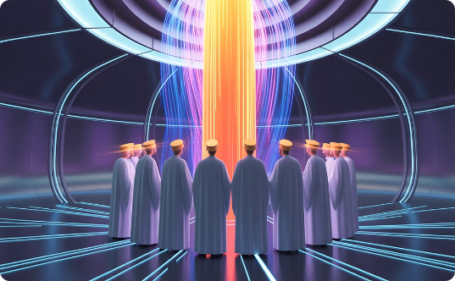
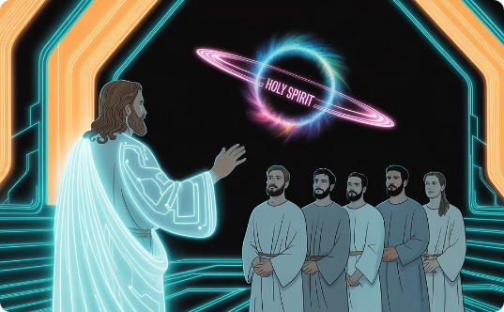
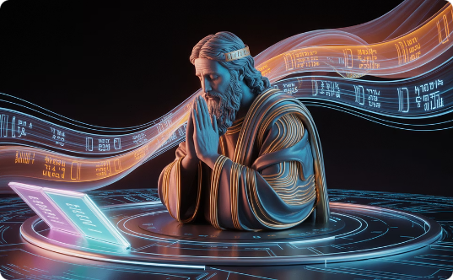
Speaking from the Spirit
Unplanned Truth
Healing Dialogue
Sacred Silence
Words that pass through you from somewhere deeper.
When what is spoken awakens something in the listener.
Sometimes the Spirit speaks through what remains unsaid.

Slide 9








The Fruit of the Spirit
Joy
Peace
Deep gladness that persists even in sorrow.
Tranquility that holds despite external chaos.
Love
Selfless care that transcends natural affection.
Patience
Endurance that waits without resentment.

Slide 10

The Slow Blooming
Blossoming
Weathering
Holiness appears not through striving but through being.
Planting
Through seasons of challenge, virtues take root.
The Spirit begins work in unseen places of the heart.

Slide 11


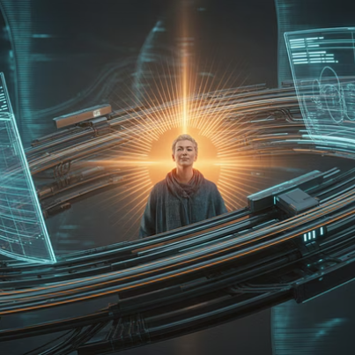

Unexpected Virtues
These moments are not random. They are signs that the Spirit is alive within you.

Slide 12

Tracing Growth
Past Struggle
Future Hope
Where patience once failed, noticing new capacity.
Trusting that holiness is being shaped even when unseen.
1
2
3
Present Fruit
Virtues appearing more often now than before.

Slide 13

One Body, One Spirit
1
Many
Common Good
Shared Gifts
"To each is given the manifestation of the Spirit for the common good."
The Spirit never isolates. He draws people together.
All
Collective Blessing
Your inner transformation is never for you alone.

Slide 14

Eucharistic Living
1
Growing in Patience
2
Practicing Forgiveness
Others are nourished by your calm presence.
Others see new possibility through your mercy.
3
Suffering Faithfully
Others glimpse hope through your wounds.

Slide 15

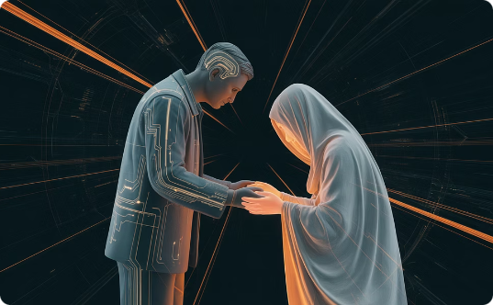

Vessels of the Spirit
Quiet Integrity
Unconscious Holiness
Beautiful Imperfection
Those who carry the Spirit not through words but through love.
Being a vessel without realizing it.
You don't have to be perfect for the Spirit to work through you.

Slide 16

The Cry of the Spirit
Words Fail
Grief Overwhelms
Doubt Lingers
Silence Weighs
"The Spirit himself expresses our plea in a way that could never be put into words." (Romans 8:26)

Slide 17

Praying from the Wound
Beyond Language
Divine Yearning
The Spirit prays in you with presence, not words.
Unspoken hope that holds you from within.
Sacred Holding
Being held even when you cannot pray.

Slide 18

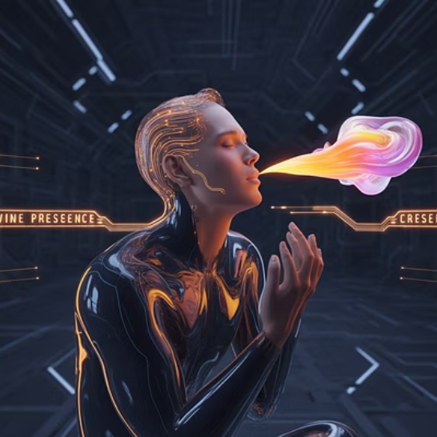

Wordless Prayer
Something holy takes place, even without understanding it. This is the Spirit at prayer within you.

Slide 19








Remaining in the Spirit
Indwelling
Life-Breath
The Holy Spirit is not a visitor but your companion.
As close as your own breathing.
Loving Presence
Inner Teacher
"The love of God has been poured into our hearts by the Holy Spirit."
Guiding from within, not imposing from without.

Slide 20





Living a Life of Pentecost
Growing Honesty
Becoming more transparent to truth.
Deepening Openness
Allowing yourself to be changed by love.
Christlike Formation
Transformed from the inside out.
Gentle Progress
Not about perfection but slow transformation.

Slide 21





Walking with the Spirit
Slow Pace
Breath Awareness
Sacred Encounters
Moving gently enough to notice divine movements.
Finding the Spirit in each inhale and exhale.
Seeing Christ in those you meet.
Interior Listening
Noticing your responses with compassion.

Slide 22

Ongoing Pentecost
Living Memory
Present Transformation
Not just a historical event but a continuing reality.
Your soul is still becoming.
Daily Renewal
Each day offers fresh opportunity for divine encounter.

Slide 23
Final Silence
Let It Sink Deep
Steady Flame
Sit quietly now. Let everything settle.
Let the flame burn low and steady. Let the breath be enough.
No more effort. No more words. Just a return to stillness.
"Come, Holy Spirit. Not to visit, but to dwell."

Slide 24

The Spirit's Prayer
Not to Visit, But to Dwell
Inviting permanent presence, not temporary comfort.
Not to Fix, But to Form
Seeking transformation, not quick solutions.
Not to Pass Over, But Through
Allowing complete permeation of your being.

Slide 25

The Spirit in Scripture
Acts 2:1-4
The coming of the Holy Spirit at Pentecost
Galatians 5:22-23
The fruit of the Spirit in believers' lives
1 Corinthians 12:7
Spiritual gifts for the common good
Romans 8:26
The Spirit's intercession in prayer
Romans 5:5
God's love poured into hearts by the Spirit

Slide 26



The Spirit's Comfort
In Sorrow
In Chaos
In Confusion
The Comforter draws near when hearts are broken.
The Spirit creates inner sanctuary amid external storms.
Divine wisdom illuminates the path forward.

Slide 27

The Spirit's Challenge
Truth
Growth
Confronting Reality
Embracing Change
The Spirit leads us to face what we avoid.
Comfort zones must be left for new life to emerge.
Love
Radical Compassion
Called to love beyond our natural inclinations.

Slide 28




The Spirit in Community
Shared Wisdom
Diverse Gifts
Discernment happens through many voices.
1
2
Each person brings unique spiritual contributions.
Collective Witness
Mutual Support
4
3
Together we embody Christ's presence.
We hold each other in times of doubt.

Slide 29




The Spirit in Creation
The same Spirit who moved over the waters at creation continues to breathe life into all things.

Slide 30




Amen: Let It Be So
Receptivity
Trust
Continuation
Remaining open to the Spirit's movement.
Believing in the unseen work of transformation.
The Pentecost journey continues in daily life.

