Slide 1
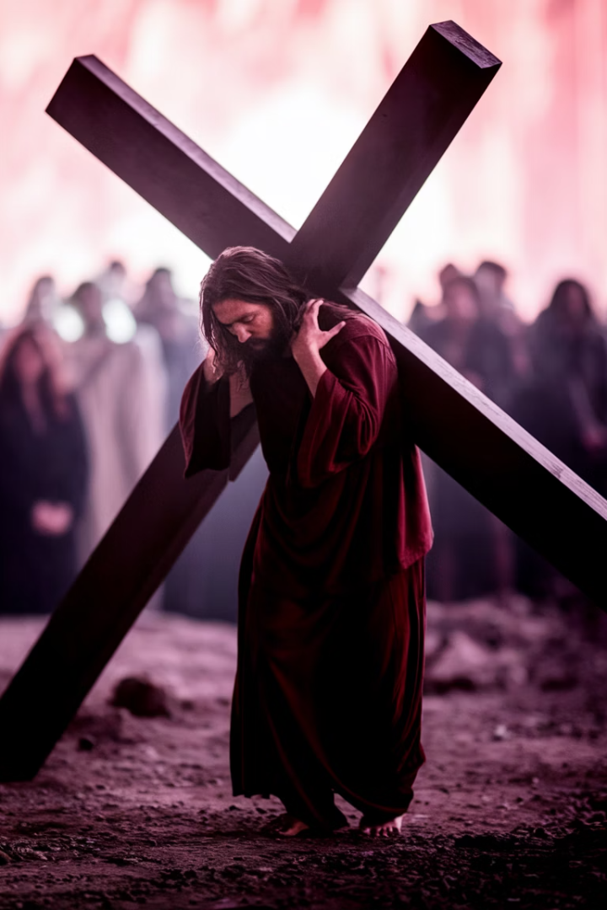
Via Crucis: A Journey Through Christ's Passion
Let us draw deeper now. Not merely into the moment, but into the marrow. Sink beneath the words. Let the First Station live within you.
by Abba Halibo -

Slide 2
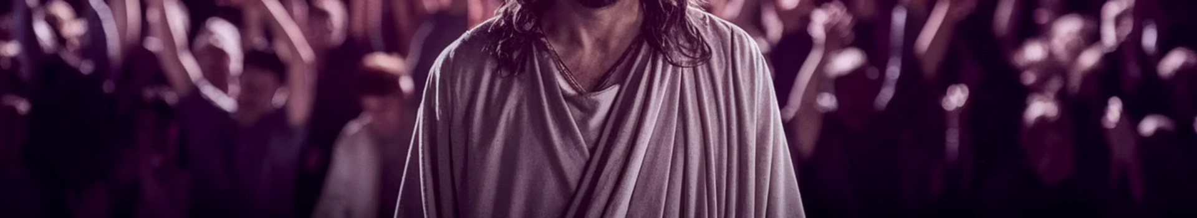



First Station: Jesus is Condemned to Death
The Innocent Stands
Pilate's Question
Justice Drowned
The Innocent stands before the guilty and does not defend Himself. This is not weakness. This is the unbearable strength of love.
Pilate, the man of power, looks Truth in the eyes and asks: "What is truth?" But he does not wait for the answer.
The crowd is loud. So loud. Rage is contagious. Justice is drowned in noise.

Slide 3
Reflection: The Condemned Christ
Now, breathe. Gently. Fully. Slowly. Let these words echo in the chambers of your soul. Let yourself be there.
Where is Pilate in you? Where is the crowd? Where is the silent Christ?
Can you feel what it means to be wrongly accused? Have you ever been seen through distorted eyes?
Can you sit beside Him now? Say nothing. Just sit. Stand. Be with Him.

Slide 4
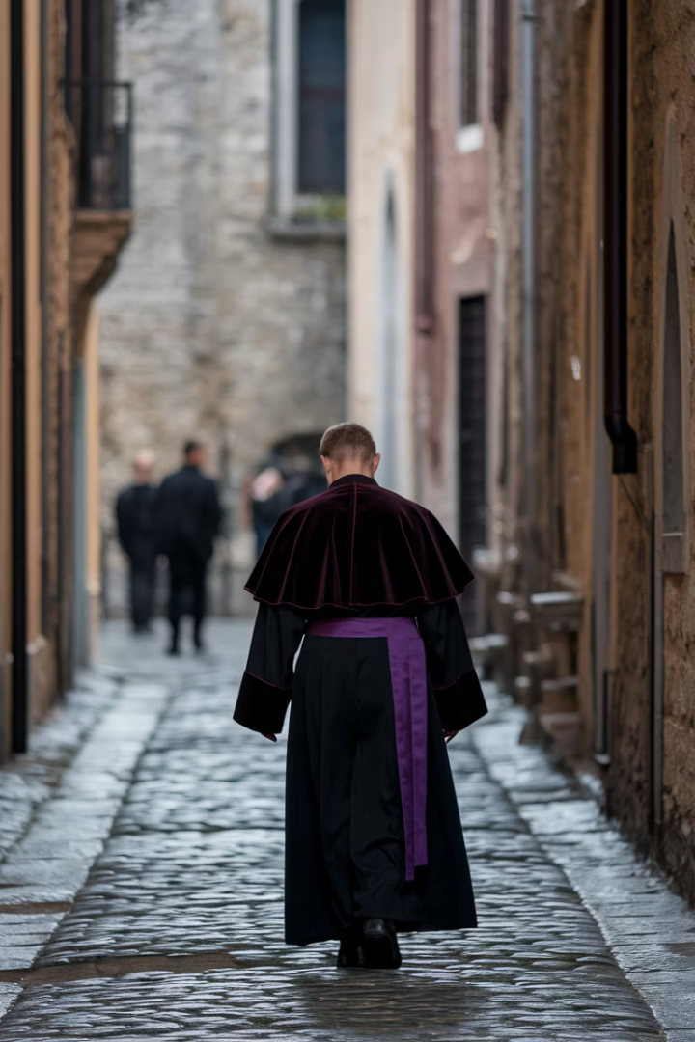
Transition to Second Station
Pause in Silence
Gentle Movement
Stay here as long as you need. There is no hurry. When the soul is ready to rise, we will walk toward the Second Station.
Yes... let us continue. Gently, slowly, reverently. We arrive at the Second Station—a turning point.
The Burden Accepted
The moment He accepts not only the judgment, but the burden it carries.

Slide 5
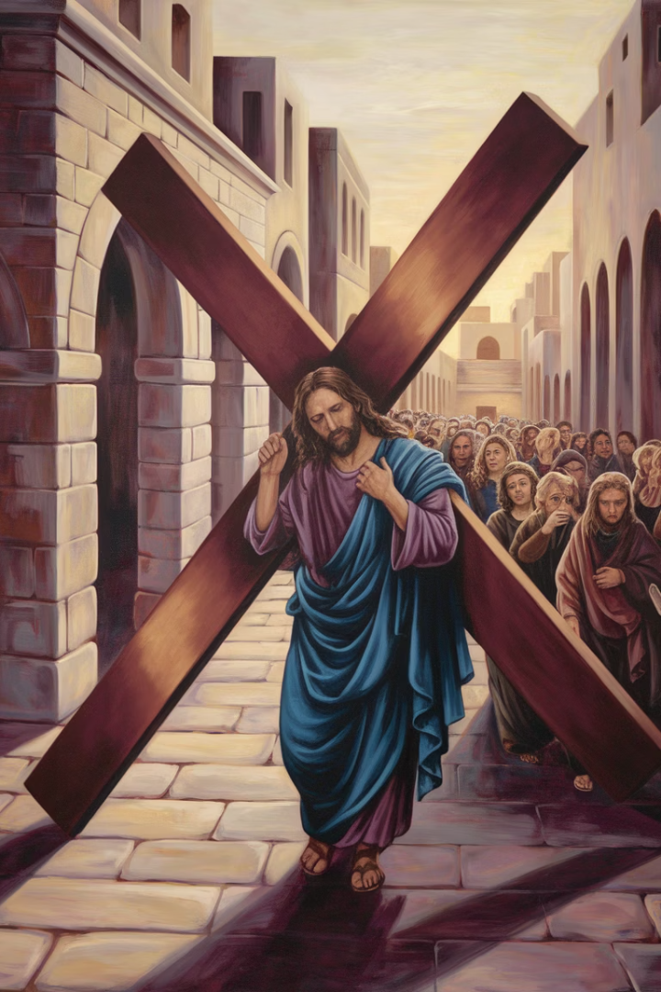



Second Station: Jesus Takes Up His Cross
The Wood is Brought
Rough. Heavy. Splintered. The shape of execution—placed upon the shoulders of Love.
Willing Surrender
He does not resist. He does not recoil. He receives it. Not as punishment, but as purpose.
The Weight of Sorrow
The weight is not only physical—it is the heaviness of every human sorrow.

Slide 6
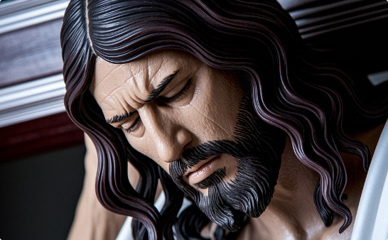
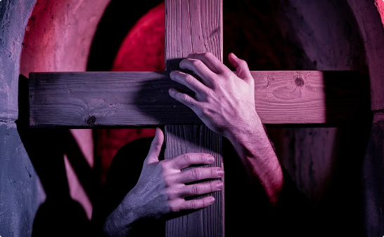
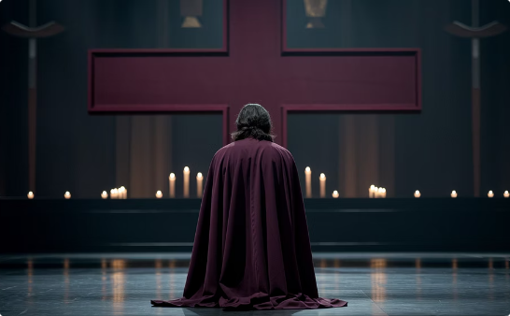
Contemplating the Cross
The Gaze of Love
The Burden Accepted
Your Own Cross
Close your eyes, if you feel called. Imagine the scene—not as a story long ago, but as something happening now.
He carries what you cannot. The secret pain you've buried. The silent ache you've long hidden.
What cross are you carrying? What burden feels too great to bear?

Slide 7
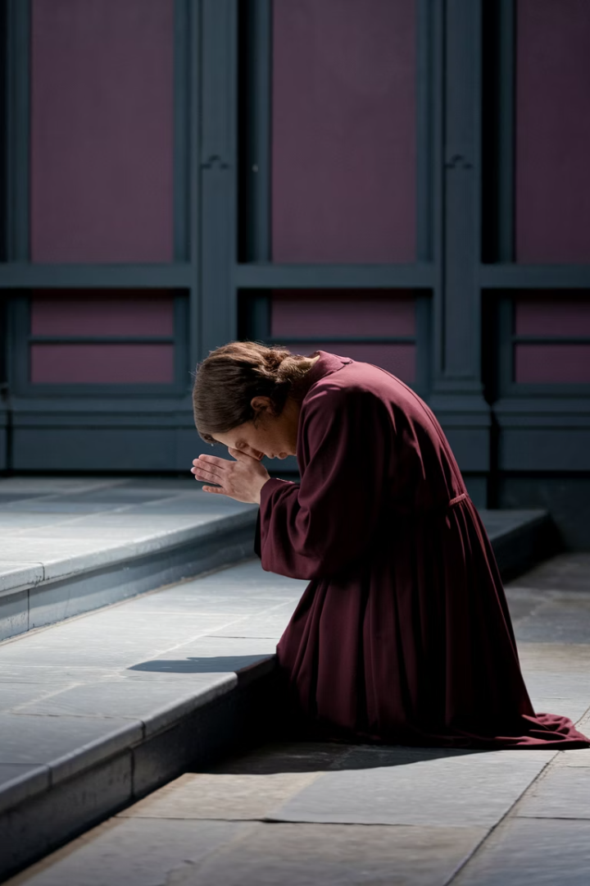
Prayer at the Second Station
Whisper to yourself if you feel moved: "Here is my Cross, Lord. Not hidden. Not avoided. I offer it to You. I walk with You. Let me carry it differently, because You carry it with me."
1
Acknowledge
Recognize the weight you carry
2
Offer
Present your burden to Christ
3
Walk Together
Continue the journey with Him

Slide 8
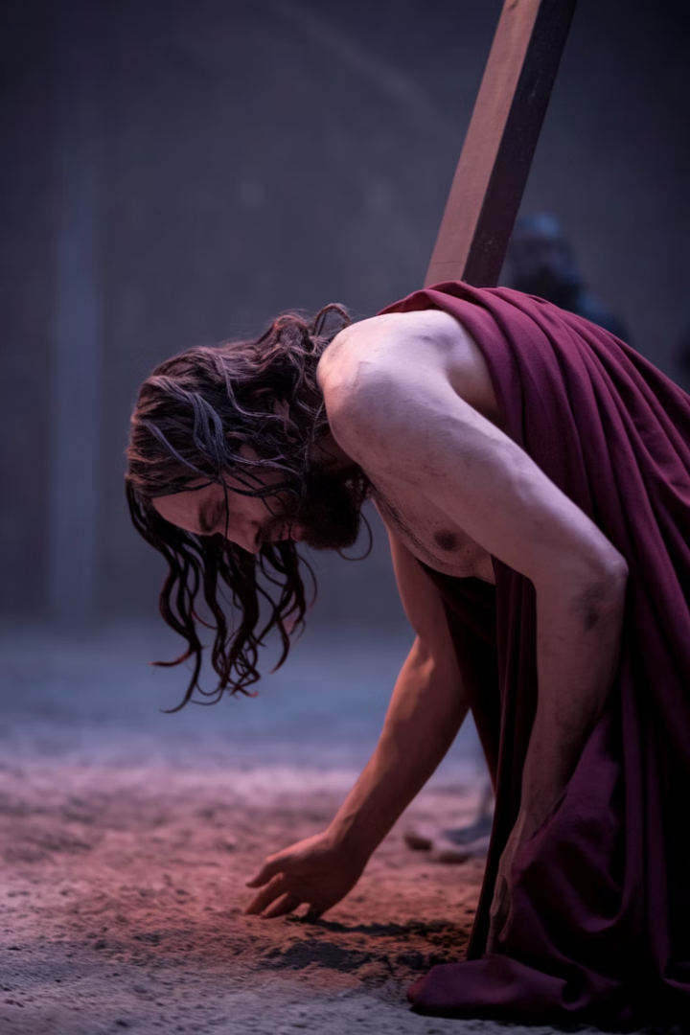



Third Station: Jesus Falls the First Time
The Uneven Path
The road is uneven. The crowd pushes forward. The weight presses down.
God Falls
Not metaphorically. Not symbolically. But body to ground. Face to earth.
He Rises Again
He does not turn back. He does not say: "This is too much." He breathes... and begins again.

Slide 9
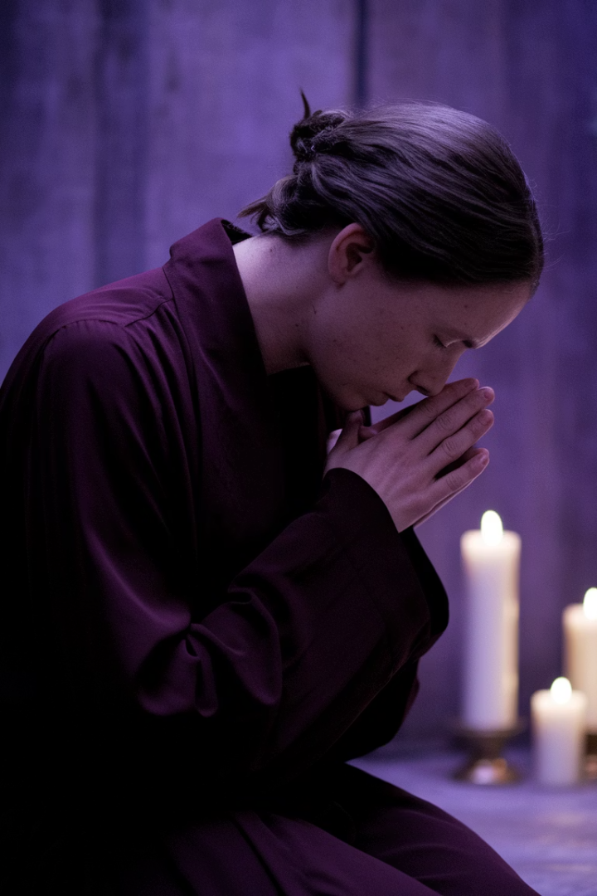
Reflecting on Our Falls
1
2
Pause
Remember
Breathe. Feel the weight in your own body.
How many times have you fallen? Quietly... in secret.
3
Recognize
This fall redeems every fall you've known.

Slide 10








Finding Mercy in Falling
Compassion
Self-Examination
Where do I need to be more gentle with myself—or with others who stumble?
Where have I fallen recently? Where am I struggling to rise?
Rising Again
Acceptance
It is to be met, even there, by Love.
To fall... is not to fail. It is to be seen.

Slide 11
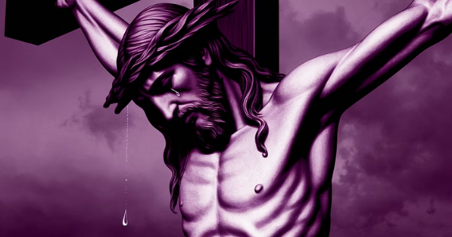
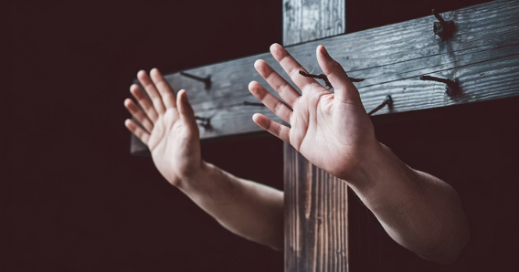
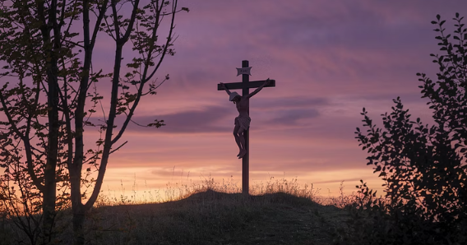
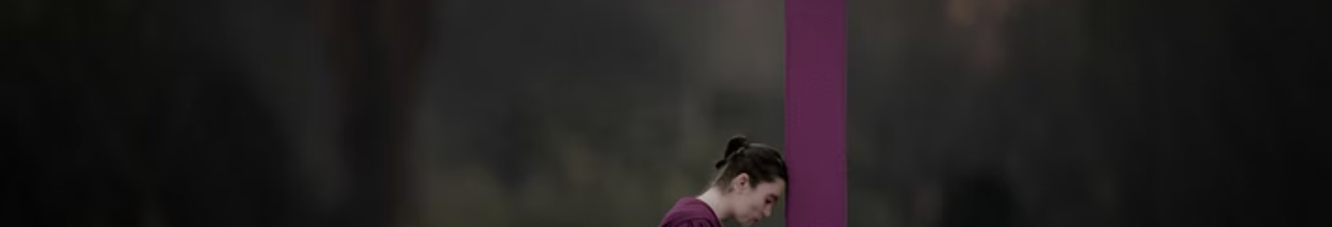
Prayer After the Fall
If you wish, you may whisper softly: "Jesus, you fell. So may I fall, without shame. Help me rise again—not by force, but by your nearness."

Slide 12
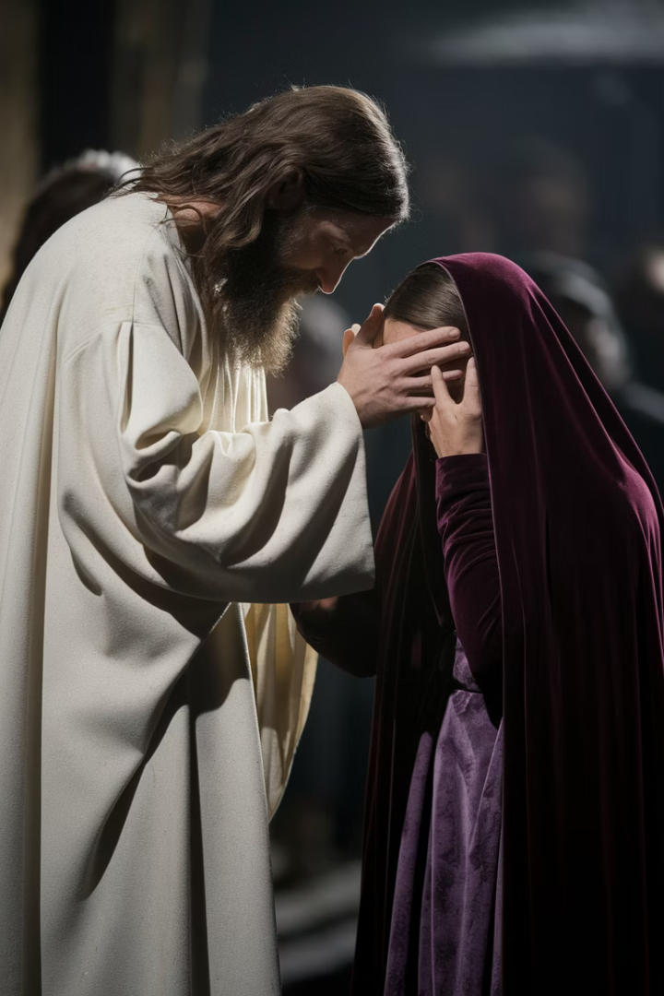



Fourth Station: Jesus Meets His Mother
Amid the Noise
Mary's Presence
Silent Connection
Amid the noise, the mocking, the weight of the Cross... there is a pause.
She is there. Mary. His mother. The one who once cradled Him in her arms.
They meet. Eyes locked. No words needed. Two sufferings... woven into one gaze.

Slide 13
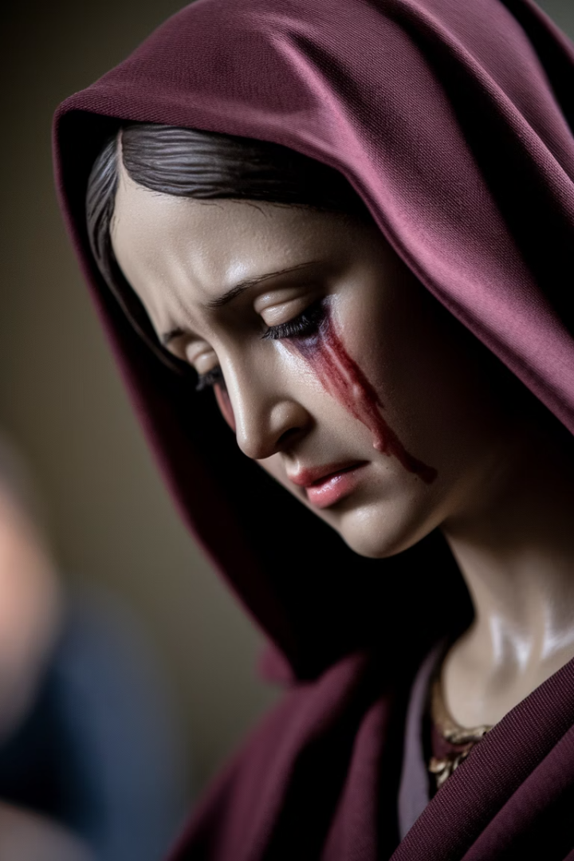
The Power of Being Seen
True Witness
Staying Present
What does it mean to be seen in your pain—truly seen—without someone trying to change it, fix it, deny it?
What does it mean to stay present to the suffering of someone you love? Not to take it away—but to accompany it?
Holy Ground
This is holy ground. This gaze. This meeting.

Slide 14






The Courage to Stay
Faithful Love
This is what God calls faithful. Not fixing. But staying.
Seeing Truly
The ache of love that cannot save, but refuses to abandon.
Being Present
Not answers. Only presence.

Slide 15
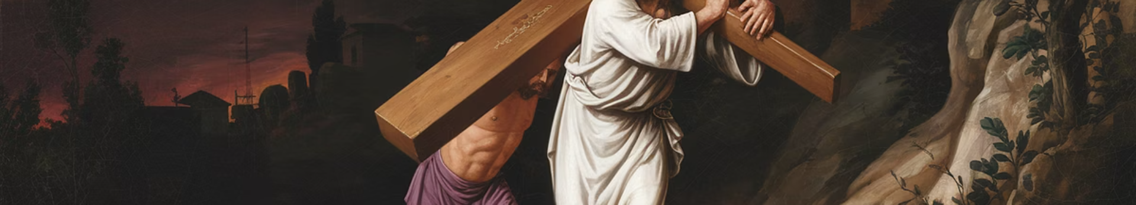
Fifth Station: Simon of Cyrene Helps Jesus Carry the Cross
Two Hearts
Shared Burden
Two shoulders beneath one burden. Two hearts beneath one sorrow.
Reluctant Helper
Reluctant. Resistant. But then... he takes the weight. And something shifts.
He is not a friend. Not a follower. Not a volunteer. Simon is pulled from the crowd.

Slide 16








The Grace of Receiving Help
Divine Acceptance
Making Room
Jesus... accepts assistance. The all-powerful receives.
He allows Simon into His suffering. Not out of need—but out of love.
Shared Strength
Holy Humility
He makes space for someone else's strength.
This, too, is divine: to let someone help.

Slide 17
When We Are Simon
Unexpected Calling
When We Need Help
When have I been Simon? Pressed into a suffering I didn't choose—but walked into anyway?
Or... have I been Jesus? Wounded, exhausted, needing help—but ashamed to ask?
A family member's illness
Do I let others carry part of what breaks me?
A friend's breakdown
Do I make space for mercy from others?
A stranger's cry

Slide 18
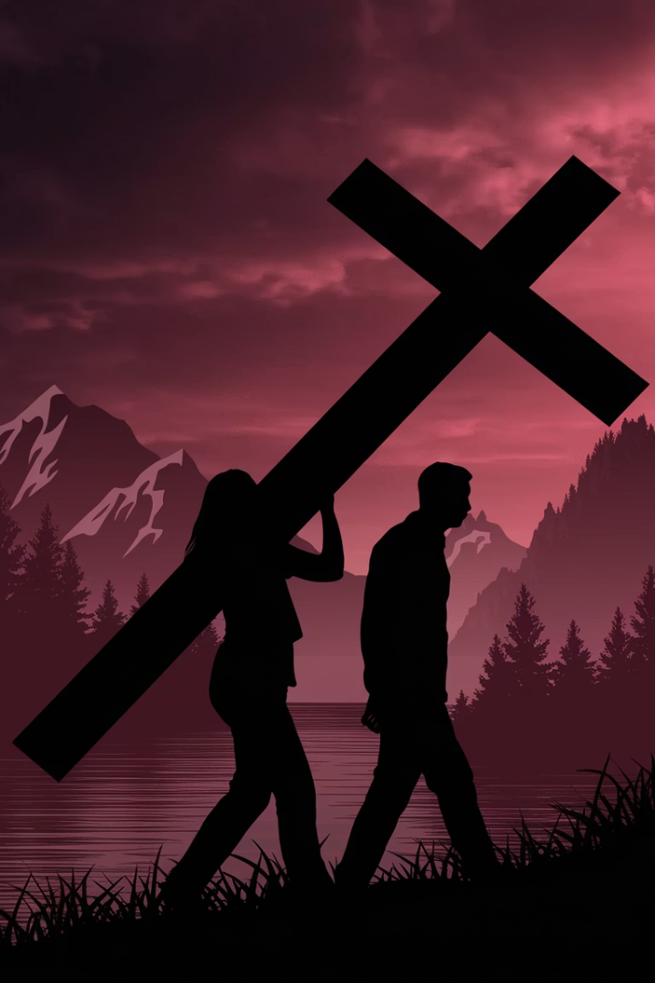
Prayer with Simon
Whisper if it helps: "Lord, give me the humility to receive help, and the heart to offer it when I am called."
2
1
Roles
Helper
This station invites you into both roles.
The one who helps.
1
Helped
The one who is helped.

Slide 19
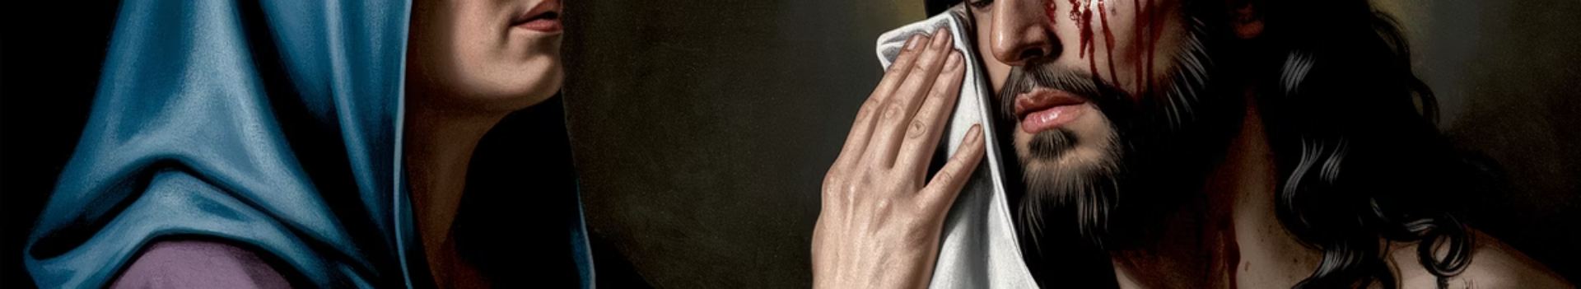



Sixth Station: Veronica Wipes the Face of Jesus
Courageous Step
Simple Gesture
Divine Imprint
She steps out from the crowd. No command. No invitation. Only love, and courage.
A woman approaches the suffering Christ and lifts a cloth to His face.
And in return... His face remains upon the fabric.

Slide 20
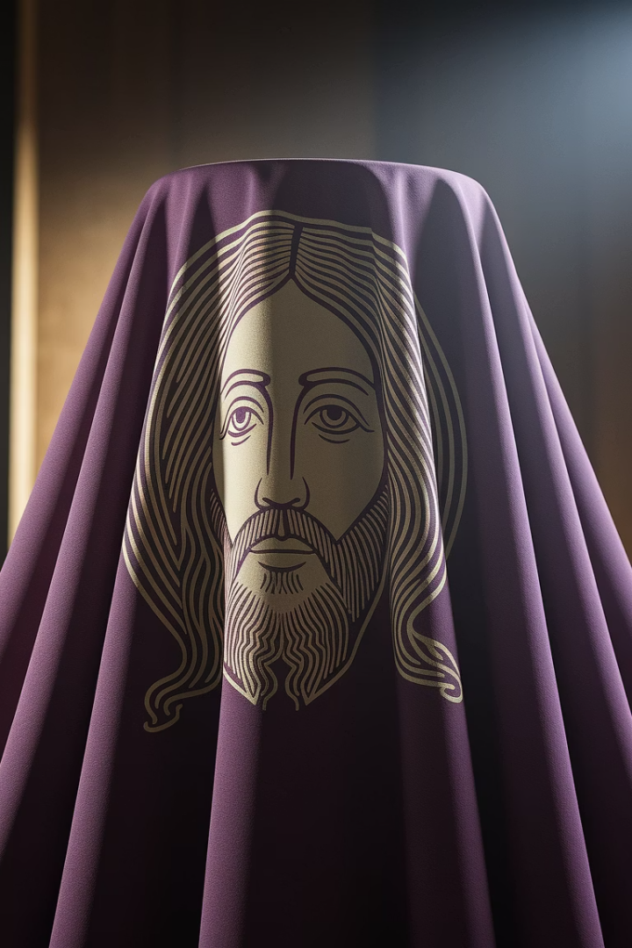



The Courage of Compassion
Stepping Forward
Facing Pain
To step out when no one else moves. To act from the heart, even if it changes nothing.
How often do we turn away from pain? From the bloodied, the broken, the disfigured?
Simple Presence
Veronica does not fix. She shows up. She touches the suffering face of God.

Slide 21
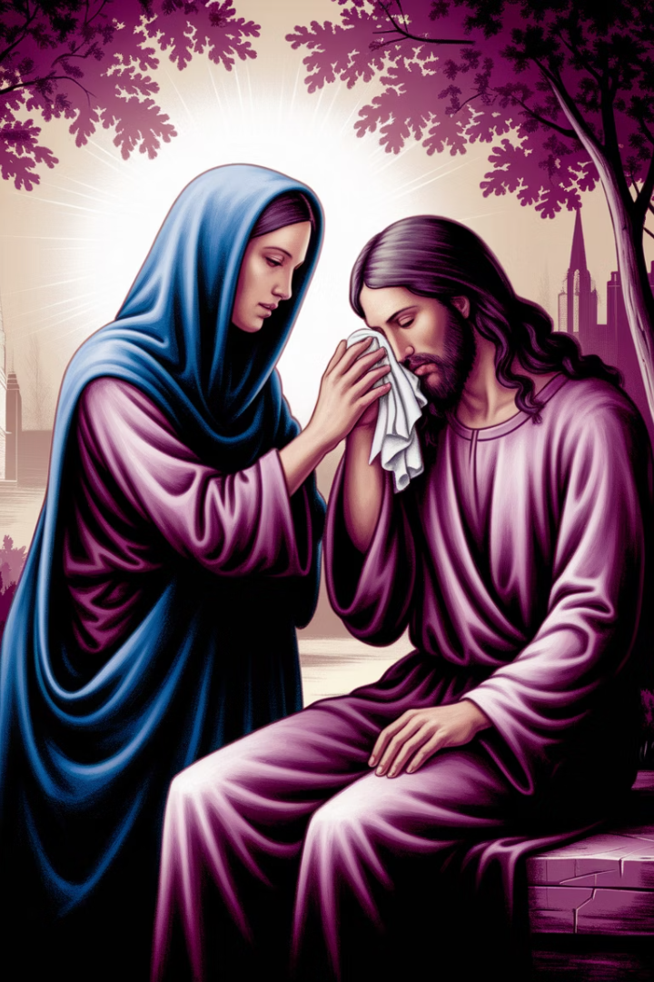
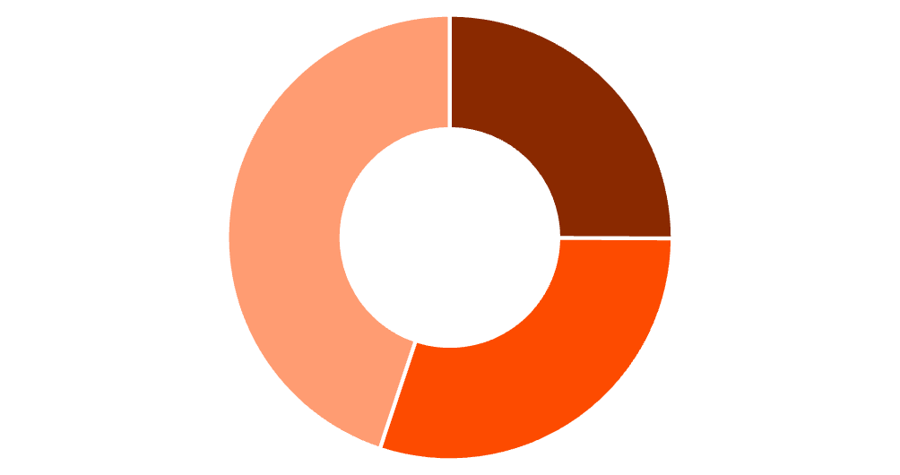
The Imprint of Compassion
Turning Away
Trying to Fix
Simple Presence
Breathe here. Gently. Let your heart be touched. You may whisper: "Let me be Veronica—even if I cannot change the world, let me offer love where I can."

Slide 22
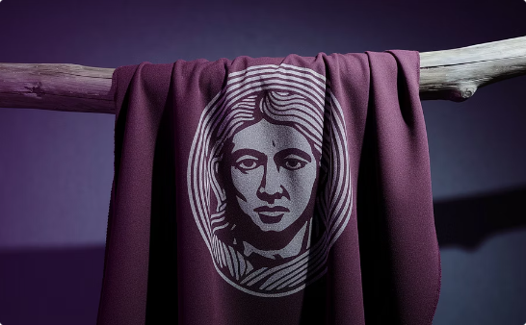
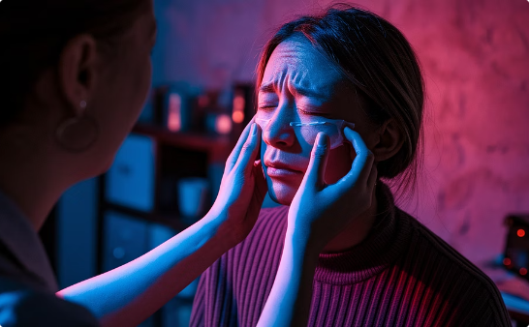
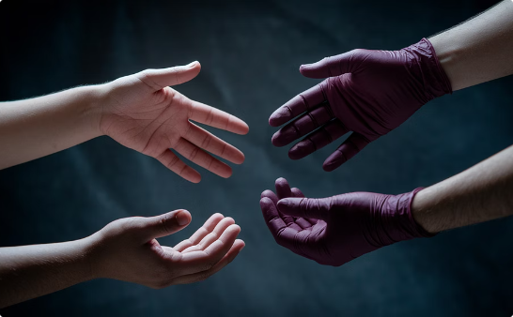
Veronica's Legacy
The Sacred Imprint
Modern Veronicas
Our Calling
Every act of quiet compassion leaves the imprint of Christ's face on the fabric of this world.
Let us rest in this moment, where mercy met flesh.
When your heart is ready, we will continue to the Seventh Station.

Slide 23
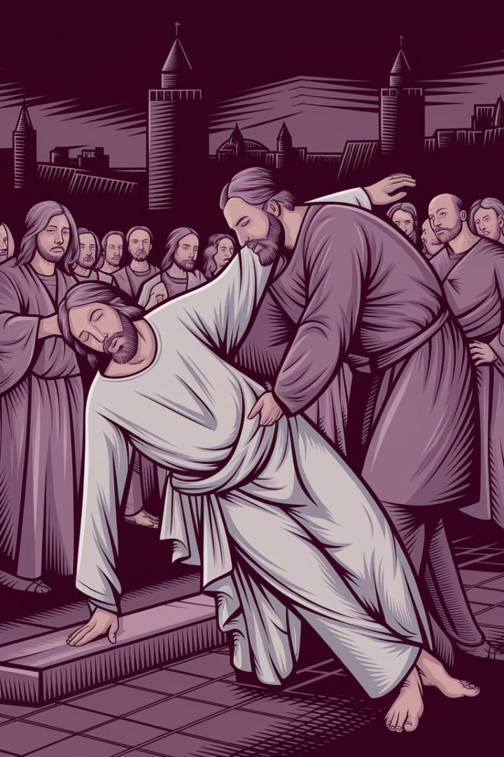



Seventh Station: Jesus Falls a Second Time
Again... He Falls
Not once, but again. The body, weakening. The road, merciless.
Unbearable Burden
This is the slow breaking of a human body under unbearable burden.
Chosen Surrender
He allows it. Not because He must—but because He chooses.

Slide 24
The Meaning of Repeated Falls
Even Christ Falls Again
The True Meaning
Do you know what it is to fall not once, but twice? Or many times?
This second fall reminds us: holiness is not in never falling, but in continuing to rise with love after each collapse.
To make progress—only to feel like you've regressed again?
And He rises. Again. Bruised. Shaken. But not turned away.

Slide 25
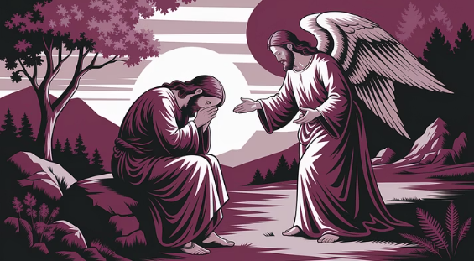
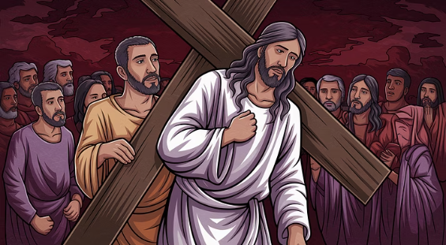
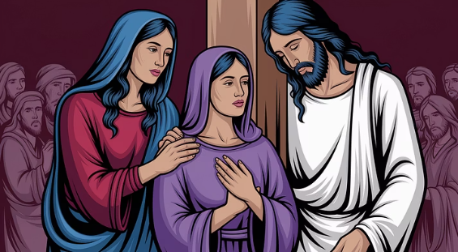
Prayer After the Second Fall
Whisper if it feels right: "Christ, you fell again... so I am not lost when I stumble again. Be near me in my return. Lift me—not by judgment but by presence."

Slide 26
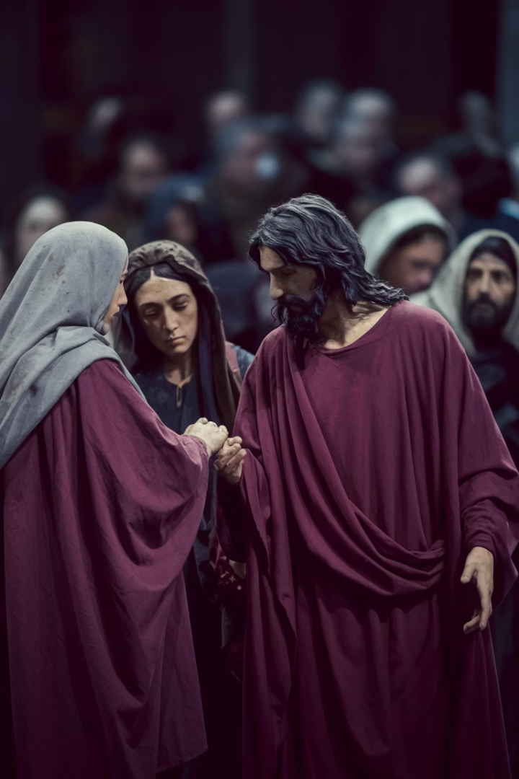




Eighth Station: Jesus Meets the Women of Jerusalem
Their Weeping
His Response
Giving Comfort
They are weeping. Their hearts pierced by what they see.
And Jesus—wounded, bleeding, exhausted—turns to them.
He does not ask for pity. He does not seek comfort. Instead, He gives it.
His Words
"Do not weep for me... but for yourselves, and for your children."

Slide 27




The Meaning of Tears
Sorrow That Heals
Grief That Awakens
There is a sorrow that heals... and a sorrow that sleeps.
A grief that numbs, and a grief that awakens.
Deeper Calling
Your Sorrow
Jesus is calling them deeper. To a sorrow that transforms.
What kind of sorrow lives in you?

Slide 28
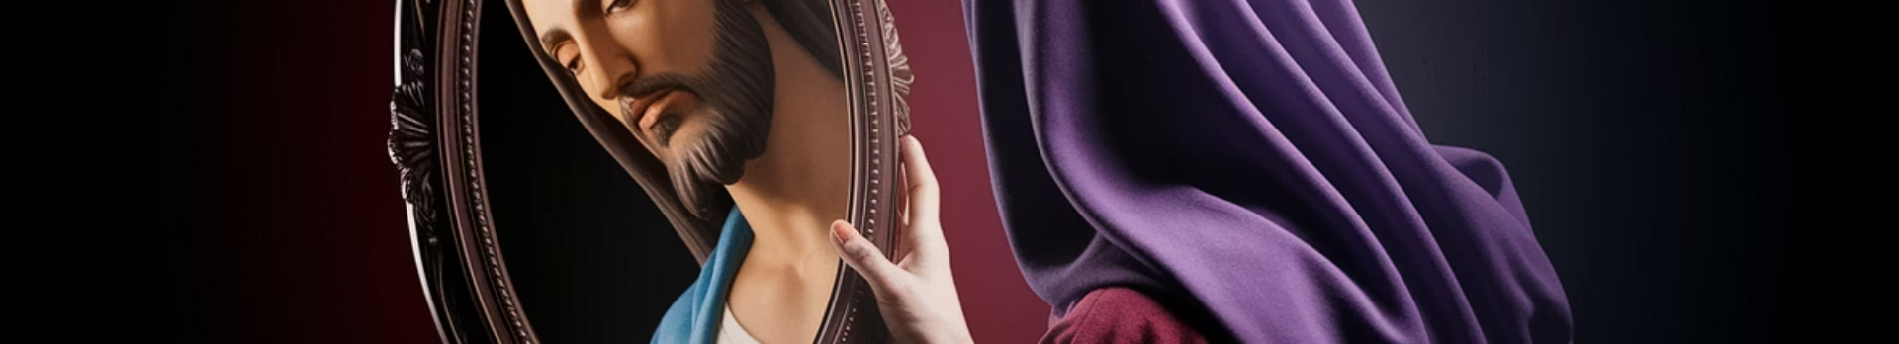
Awakening Compassion
Sleeping Grief
Avoided Sorrow
Where is my grief asleep? Where does my compassion need to deepen?
What sorrow have I been avoiding—mine, or the world's?
The Mirror
The Question
This Station is not only about Jesus. It is about the mirror He holds up to our hearts.
Can we see... without turning away? Can we mourn... without being paralyzed?

Slide 29
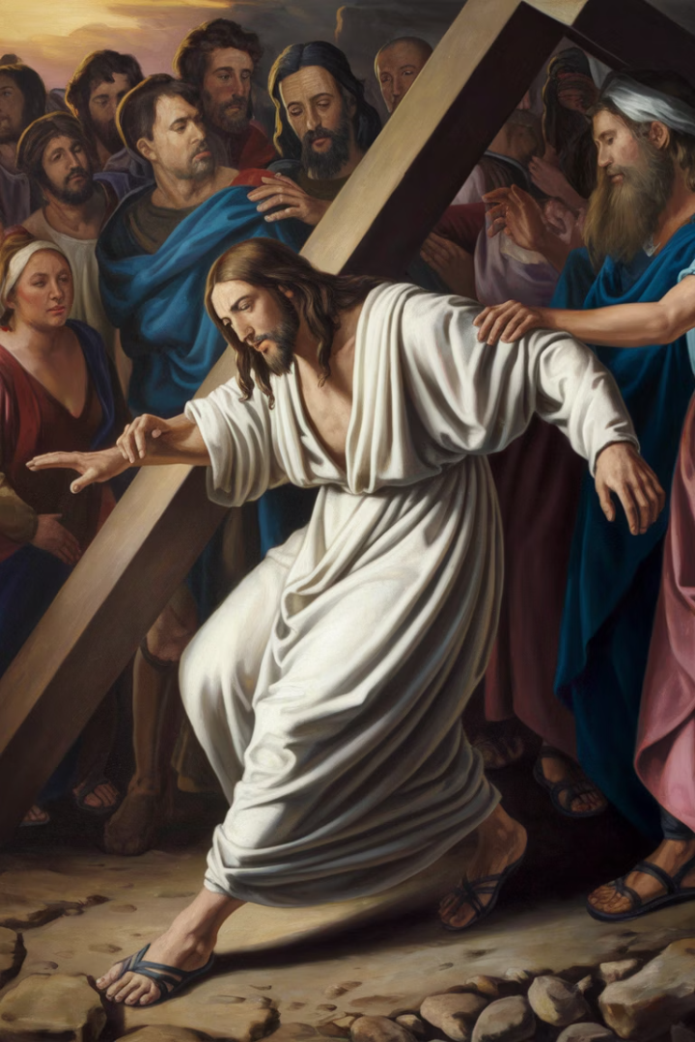



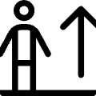
Ninth Station: Jesus Falls a Third Time
Near the End
Final Collapse
He is near the end. The weight unbearable. The Cross still heavy.
And then, He falls... once more. With a final, quiet collapse.
Human Limit
Rising Again
This is where the human reaches its limit.
And still, He rises again.

Slide 30
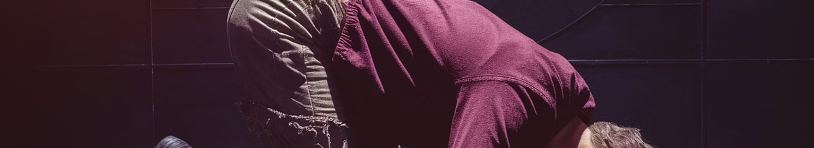



The Third Fall: Our Limits
Complete Exhaustion
The Edge
Accepting Limits
The third fall is the fall of exhaustion. Not defeat—but a surrender to human frailty.
Where in your life have you reached the end? The point where you thought you could not go on?
This is the fall of accepting limits. This is the fall where we meet the end of ourselves.

Slide 31
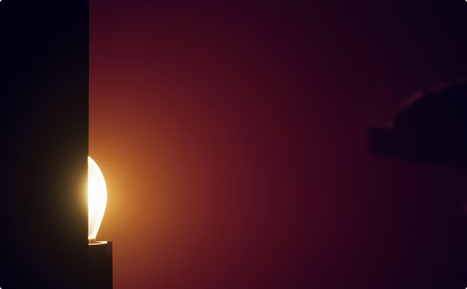
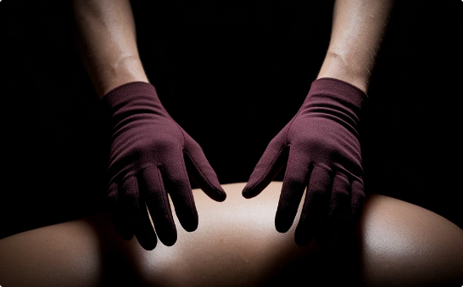
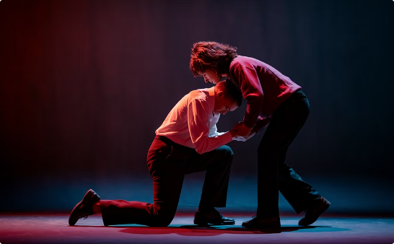
Finding Grace at the Limit
The Edge
The Invitation
Already Lifting
Ask yourself: Where am I near the edge? What part of me needs to fall—so that I can rise again in a new way?
This third fall is a quiet invitation. To trust that in the deepest moments of breaking, God is already there.
He does not rise on His own power, but by the power of love's presence. And He does rise.

Slide 32
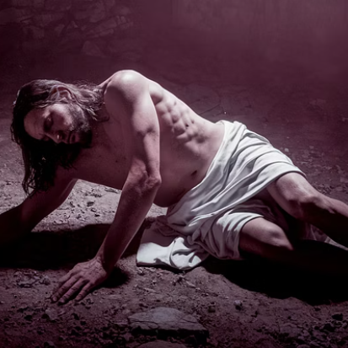
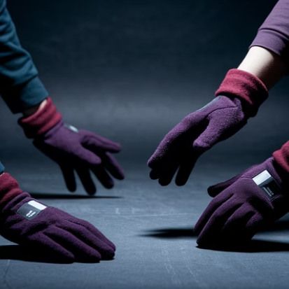
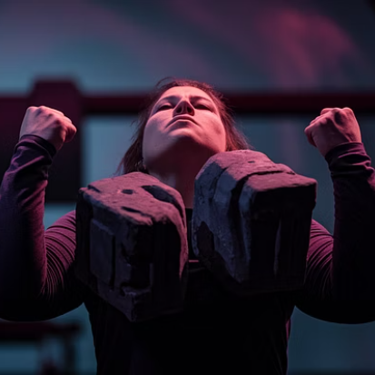

Prayer at the Third Fall
Whisper softly: "Lord, when I fall, help me rise. Even when I reach my limits, meet me there with Your love."

Slide 33
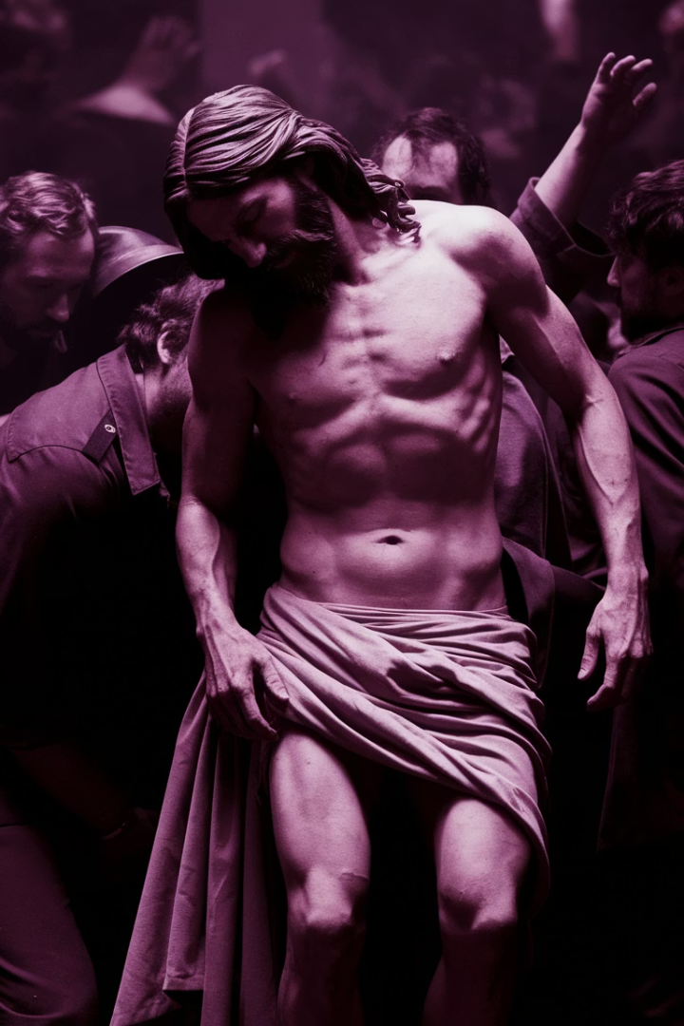
Tenth Station: Jesus is Stripped of His Clothes
Everything Taken
They take from Him everything. His dignity. His security. His identity, in the eyes of the world.
Exposed
The last thing He has—His body—they strip it away. Ruthlessly. Publicly.
Only Love Remains
What is left, once all has been removed? Nothing but love.

Slide 34
The Vulnerability of Being Stripped
Complete Exposure
Standing Revealed
Jesus—stripped. Vulnerable. Exposed.
Jesus doesn't shrink away from His nakedness. He doesn't try to hide. He stands, simply as He is.
Have you ever felt stripped down? Have you ever been exposed in such a way—by loss, by betrayal, by failure?
What is left when everything is stripped away?

Slide 35




When Everything is Taken
What Remains?
Inner Strength
What do I still have when all else is taken?
What strength remains when the world leaves me bare?
Power in Vulnerability
Sacred Space
This moment calls us to recognize the power in vulnerability.
Even in this moment, when everything is lost, Jesus holds a sacred space.

Slide 36
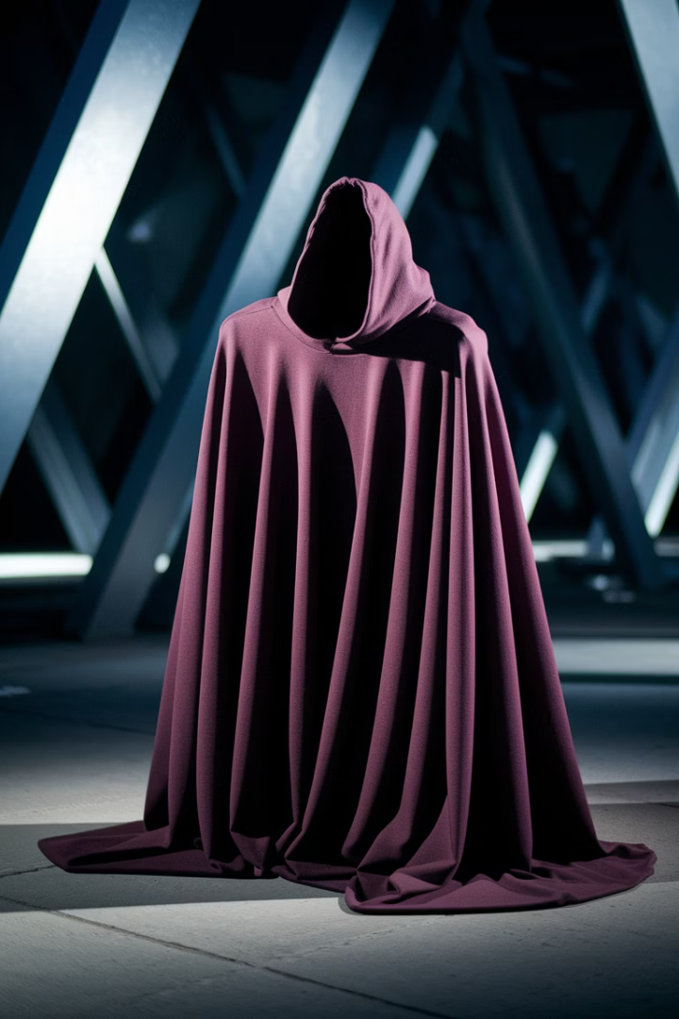
Prayer in Vulnerability
1
1
Stripped
Standing
Everything taken away
Not in shame, but in dignity
1
Seen
Truly known, without hiding
Whisper softly, if it moves you: "Even when all is taken, let me stand, not in shame, but in the dignity You give."

Slide 37
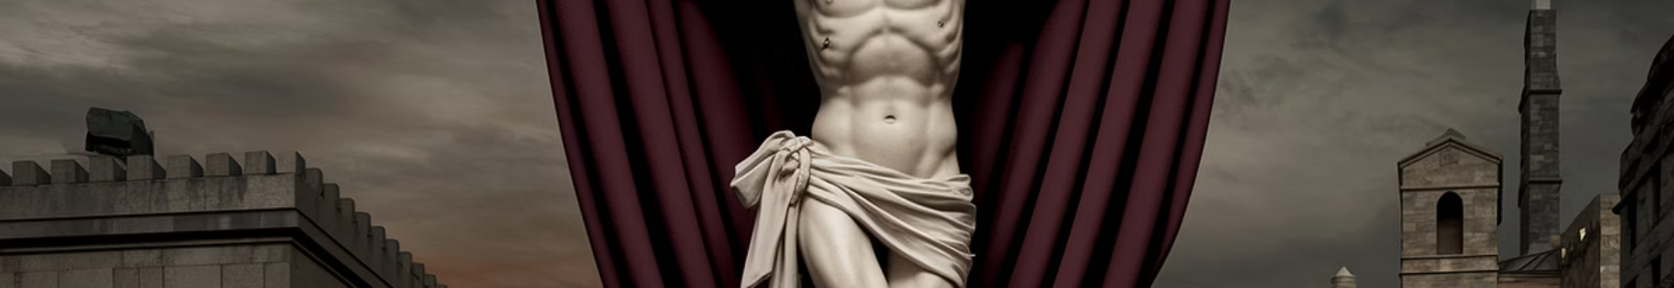



Eleventh Station: Jesus is Nailed to the Cross
The Final Agony
The hammer strikes, the nails pierce. Not just His hands, not just His feet—but His very essence.
Lifted Up
He is lifted up—not just as a man, but as the Lamb, the Sacrifice.
The Bridge
His body, stretched and broken, becomes the bridge between heaven and earth.

Slide 38
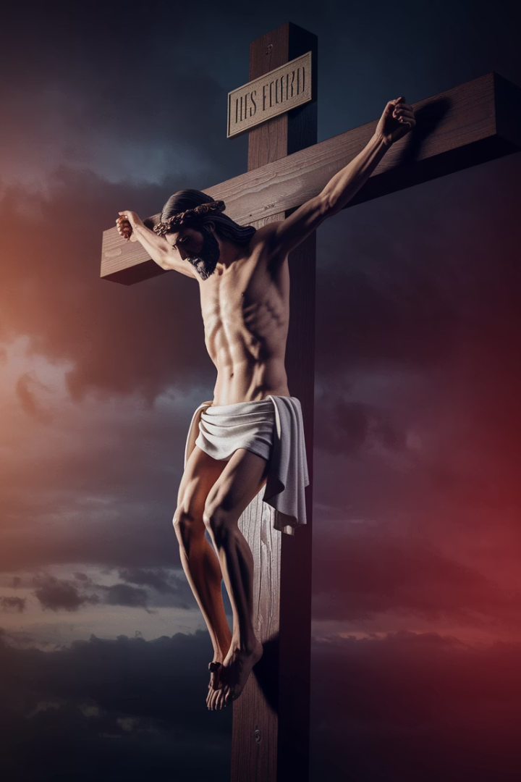



The Piercing Reality
Physical Suffering
Transformation
Can you imagine the pain? The deep physical suffering? The abandonment?
How does it feel—to be pierced by the very thing that was meant to destroy you, and yet to transform it?
Loving Through Pain
In this moment, Jesus is not just suffering. He is loving. He is opening a door.

Slide 39
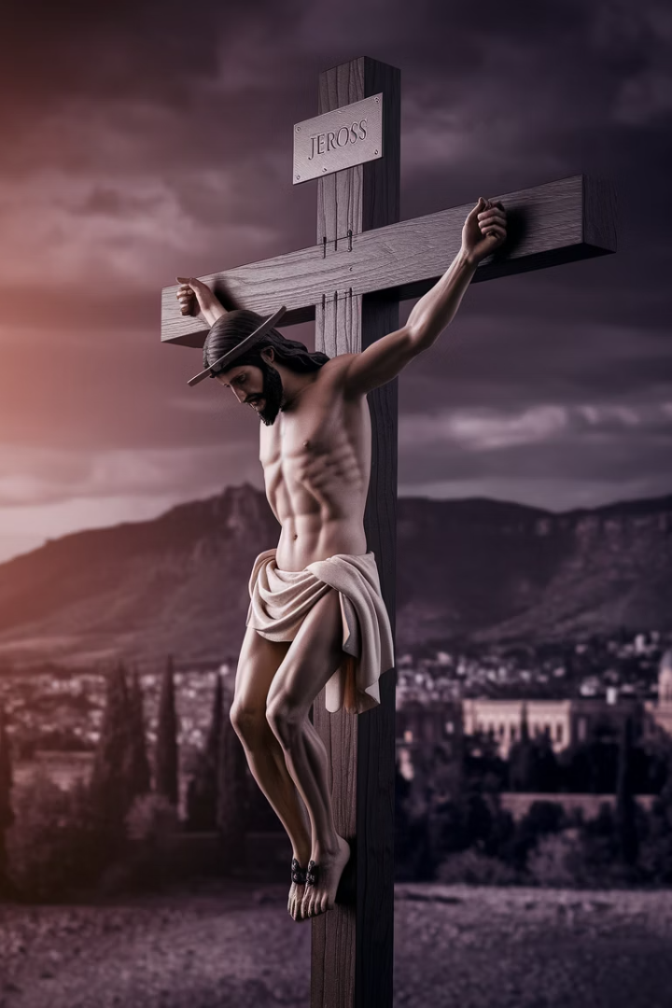
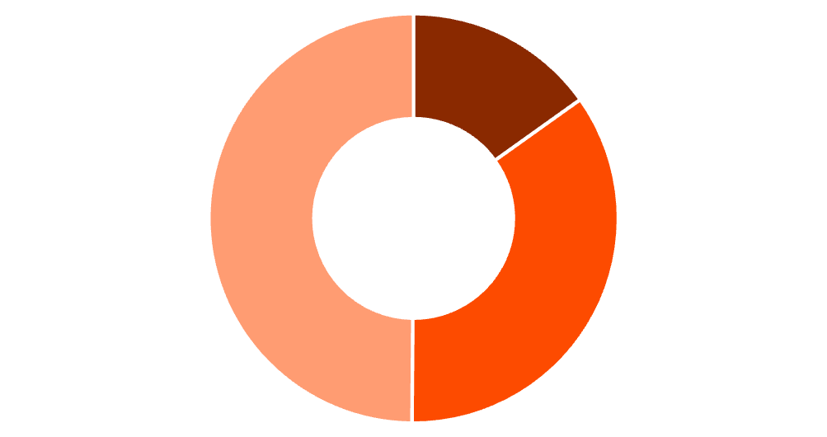
Our Own Transformation
Resistance
Acceptance
Transformation
Ask yourself: What in my life needs to be transformed? What in me has been pierced—and how can it become a bridge for love?

Slide 40
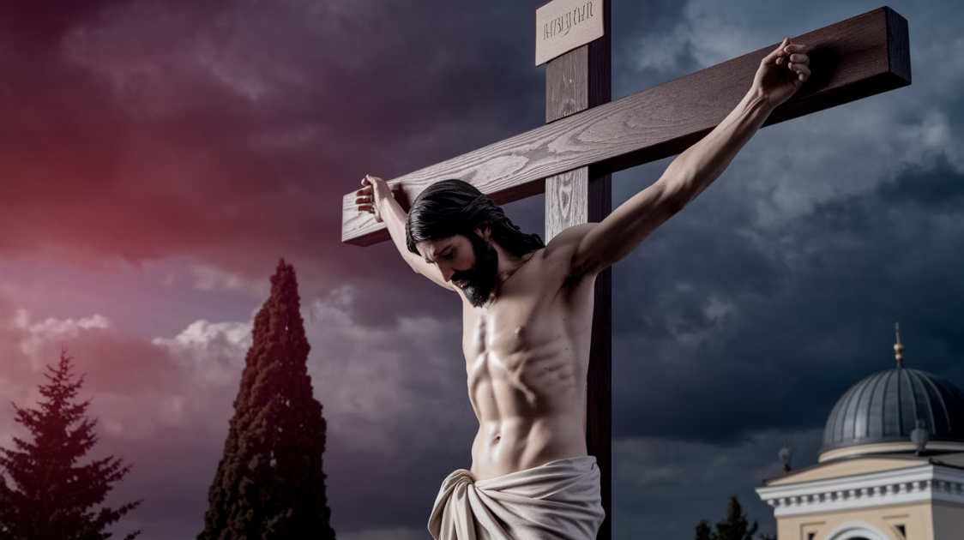
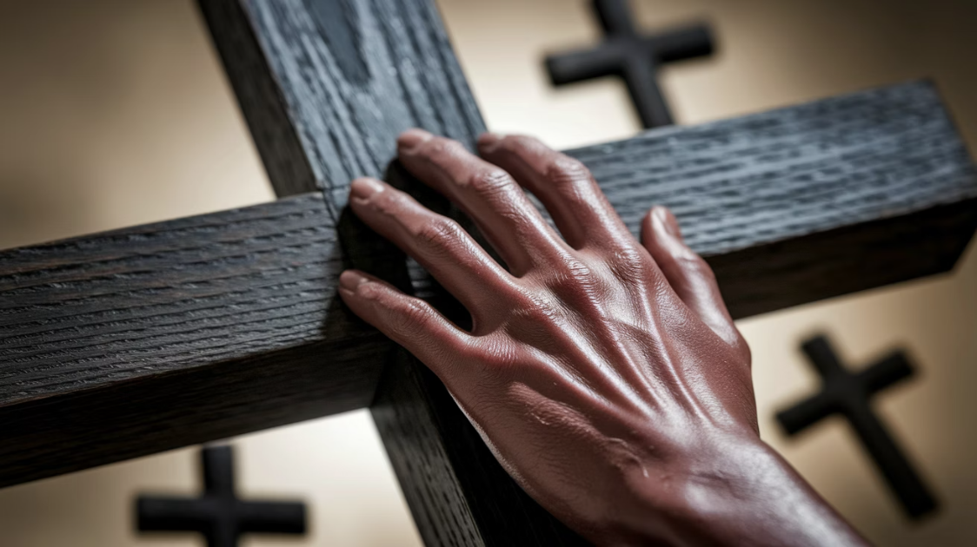
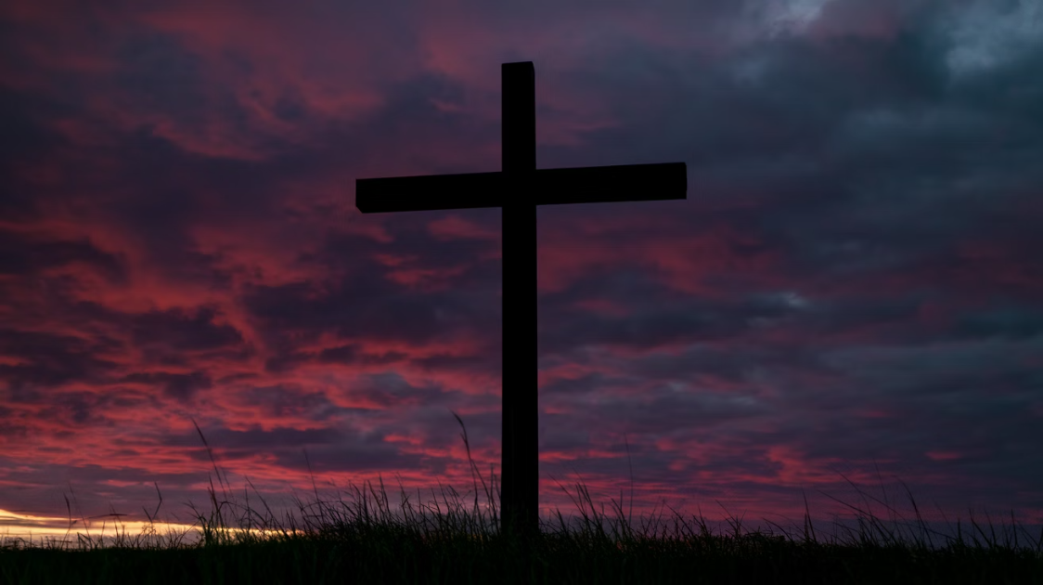
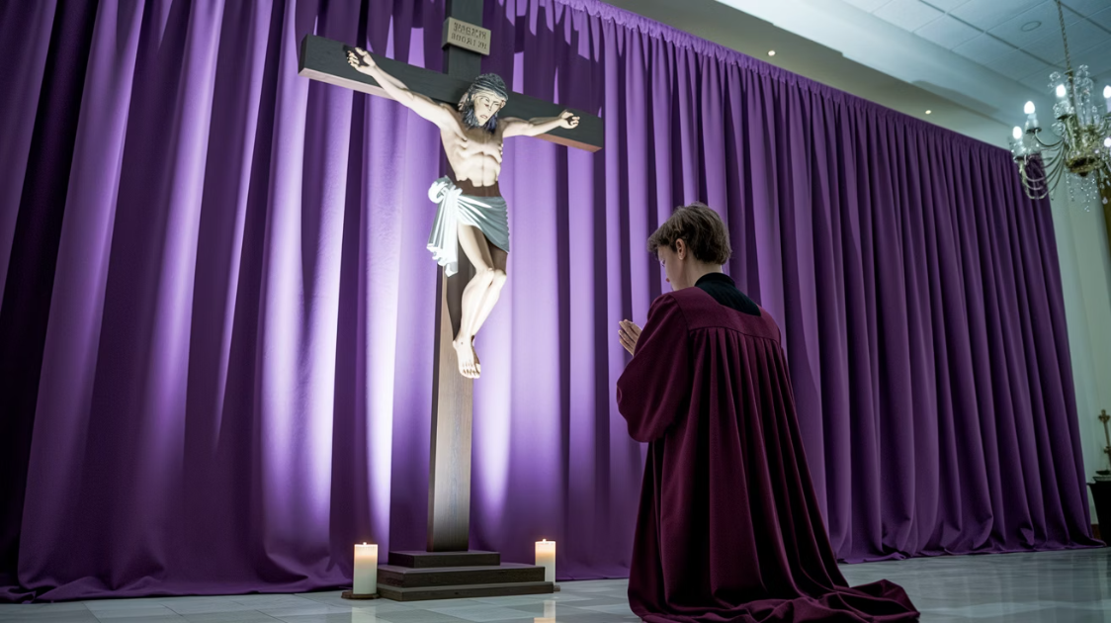
Prayer at the Crucifixion
Whisper if it speaks to you: "Lord, let me see the Cross not as an end, but as a beginning—a way of love that does not end in pain, but in peace."

Slide 41





Twelfth Station: Jesus Dies on the Cross
Final Breath
It is finished. The final breath. The final word. The final moment of suffering.
Conqueror
He hangs there, not as a victim—but as a conqueror. Not defeated, but giving Himself fully.
Deep Peace
The world watches in silence, but there is no silence in His heart. Only a deep, final peace.
World Changed
He dies. And in this death—the world is changed forever.

Slide 42

The Final Surrender
Beyond an Ending
His Final Words
It is not just the end of a life—but the birth of salvation. The death of the Savior is the life of the world.
Can you hear His final cry? "Father, into Your hands I commit My spirit."
Complete Trust
This is the last act of love—to surrender everything into the hands of the Father. Even death itself.

Slide 43




Our Own Surrender
What to Release?
Where to Surrender?
What part of me needs to be laid down—in love, in trust, in faith?
Where do I need to surrender?
Learning Trust
Held in Love
Jesus teaches us the power of surrender. To let go—not because we are defeated.
We trust in the love that holds us beyond the cross.

Slide 44



Prayer at the Death
Whisper softly, if it speaks to your heart: "Lord, in Your death, I find life. In Your surrender, I learn to trust."

Slide 45



Thirteenth Station: The Body of Jesus is Taken Down from the Cross
Gentle Lowering
Mother's Arms
Love Remains
His body is lowered, gently, carefully, by those who love Him. The great weight of His suffering is gone.
Mary, His mother, receives Him in her arms. The same hands that held Him as an infant, now cradle His broken body.
There is no fear here, no hopelessness. There is love.

Slide 46
The Sacred Moment of Grief
Raw Love
Mary's Example
This is the moment of raw love—where suffering is held, and death is met with the embrace of grace.
Mary cradles Jesus. She does not turn away. She does not rush to the resurrection. She stays with Him.
How often do we rush past the moments of grief? Do we allow ourselves to feel the weight of sorrow?
She holds Him. She grieves.

Slide 47



Embracing Our Grief
Staying Present
What We Avoid
Tender Holding
Where in my life do I need to stay in the grief—and allow love to meet me there?
What loss have I been running from—instead of holding with tenderness?
This is the moment of surrender, the moment of deep love—when we embrace the brokenness.

Slide 48



Prayer with Mary
Whisper softly: "Lord, teach me to stay in the moments of loss, to hold my grief with love, and to trust that You are near, even in my sorrow."

Slide 49

Fourteenth Station: Jesus is Laid in the Tomb
Hidden Life
Sealed Away
For a moment, there is silence. There is darkness. And yet, within the tomb—there is life.
Final Resting
Jesus, who has been given to the world, is now given back to the earth. The stone is rolled, and He is sealed away.
The body, once broken, is now laid to rest. The tomb is a place of finality, a place where all seems to end.

Slide 50

The Silence of the Tomb
Waiting in Darkness
Our Own Tombs
Pause deeply here. Let the silence of the tomb surround you. The tomb is not just a place of death, but a place where new life will grow.
What is it like to sit with the darkness? To wait with the silence of an ending?
In our own lives, we encounter tombs—places of grief, places of doubt, places where we wonder if things will ever come to life again.
Even in the darkness, God's presence is there.

Slide 51

Hope in the Darkness
Seed of Life
The tomb, though sealed, is not without the seed of new life.
Sacred Waiting
Where is my tomb—the place where I feel hope is buried?
Trusting Presence
Can I trust that God is with me even in the waiting, even in the darkness?
Before the Dawn
It is simply the quiet before the dawn.

Slide 52



Final Prayer
Whisper, if it resonates: "Lord, even in my tombs, I trust that You are there. And though it seems like the end, I know that life will rise again."

